Slide 1
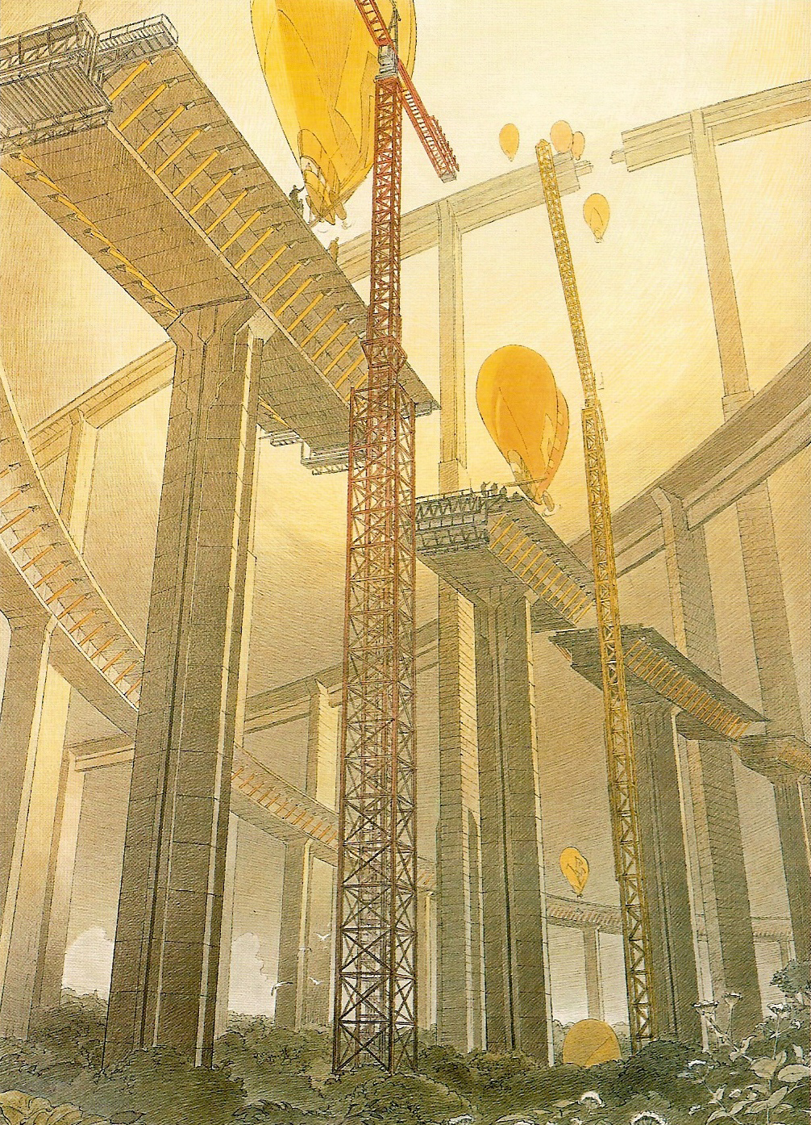
Part 7: Building Ontologies
■ Example: - Seat Terminology
■ Graphical Tool: - CmapTools
■ Formal Tool: - Protégé
■ Dedicated Tool: - Tedi

Slide 2
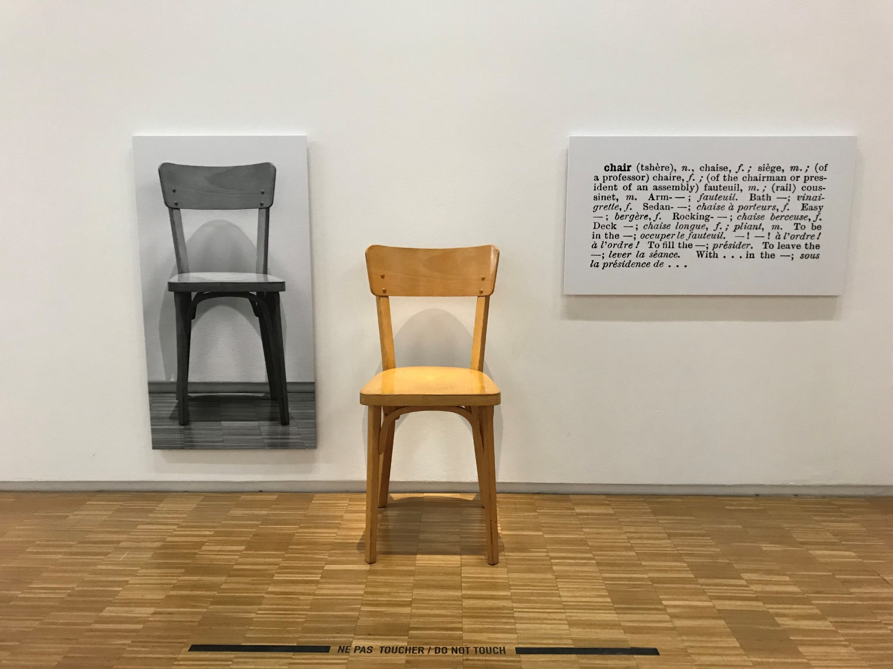
Exercise
Definition of: - “chaise” ? French
- “chair” ? English
- “椅子” ? Chinese

Slide 3
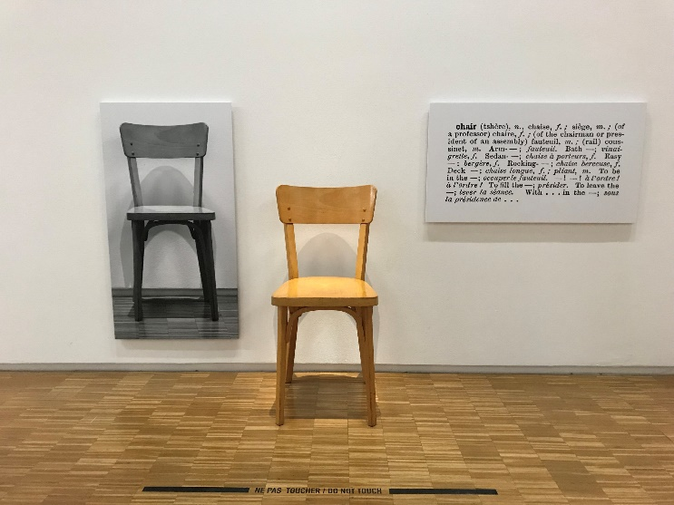
Exercise
Definition of: - “chaise” ? French
- “chair” ? English
- “椅子” ? Chinese
Terminology: the definition of a term is the definition of the concept denoted by the term expressed in a natural language
How to define the concepts denoted by the terms “seat”, “chair”, “armchair”, “bench”, etc. ?
What is (are) the difference(s) between:
- a chair and a armchair ?
- a chair and a bench ?
- a couch and a bench with back and arms ?
- …

Slide 4
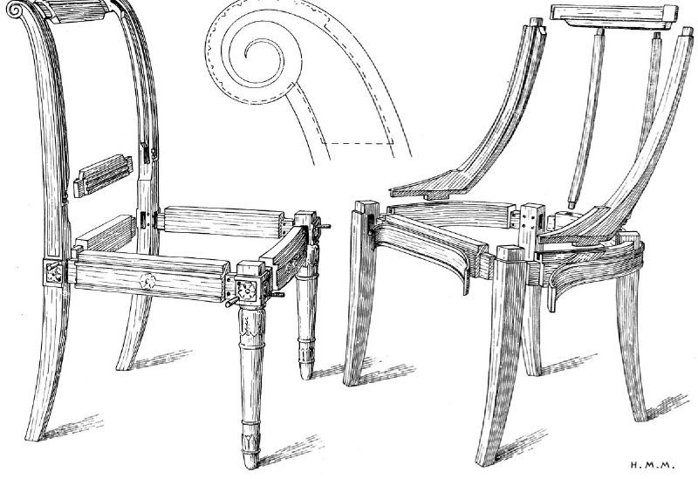
Array of Differences
Essential characteristics:
- for one person or for several persons
- with feet or without feet
- with back or without back
- with arms or without arms
- for interior or for exterior
- confortable or not confortable
Descriptive characteristics:
- material
- colour
- weight
Parts of :
- arm
- feet
- back

Slide 5
Array of Differences
Axis of analysis
Axis of analysis
Axis of analysis
Axis of analysis
Terms
Concepts | for one person | several persons | with feet | without feet | with back | without back | with arms | without arms | Designations (English) | Designations (French)
<Seat 1 person with feet with back without arms> | X |  | X |  | X |  |  | X | “chair” | “chaise”
<Seat 1 person with feet with back with arms> | X |  | X |  | X |  | X |  | “armchair” | “fauteuil”
<Seat 1 person with feet without back without arms> | X |  | X |  |  | X |  | X | “stool” | “tabouret”
<Seat several persons with feet with back with arms> |  | X | X |  | X |  | X |  | “couch” | “canapé”
<Seat several persons with feet without back without arms> |  | X | X |  |  | X |  | X | “bench” | “banc”
<Seat for one person with feet with back without arms>
::= <Seat> + /for one person/ + /with feet/ + /with back/ + /without arms/
“chair” : Seat for one person with feet and back without arms.
"chaise" : siège à dossier et généralement sans bras.
"chair": seat with backrest and generally without arms

Slide 6
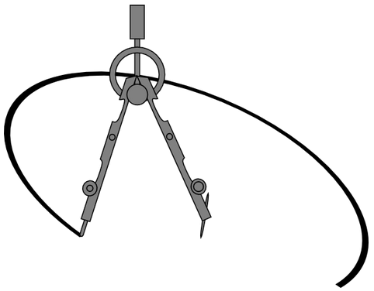
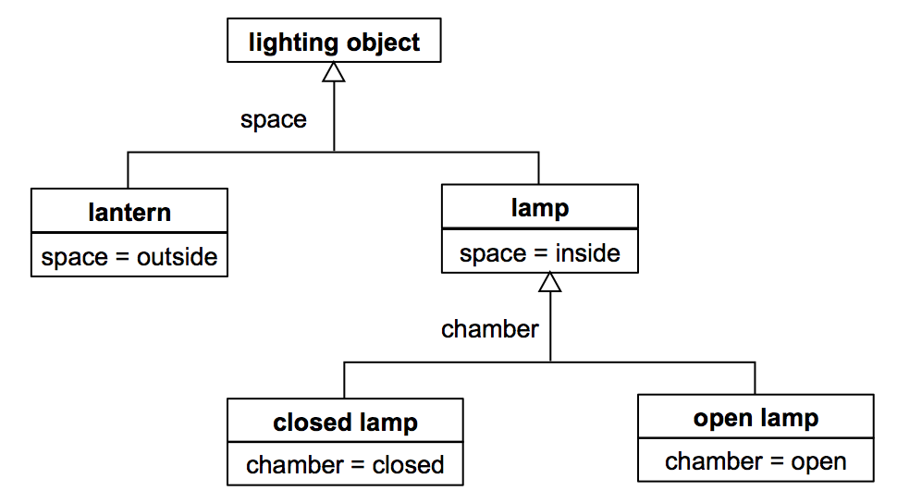
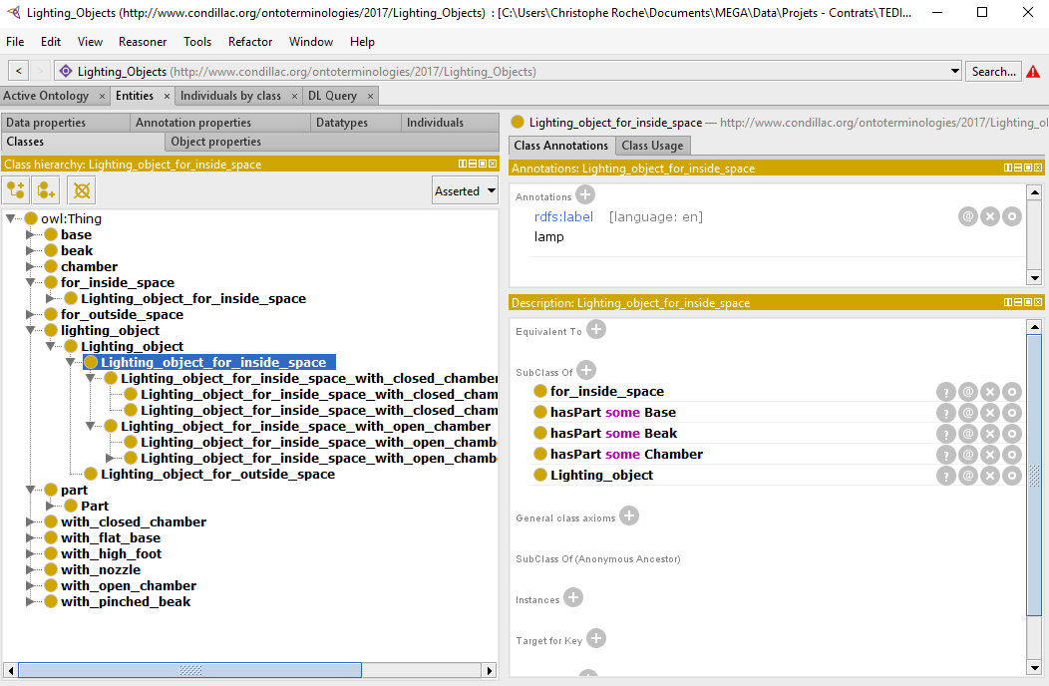
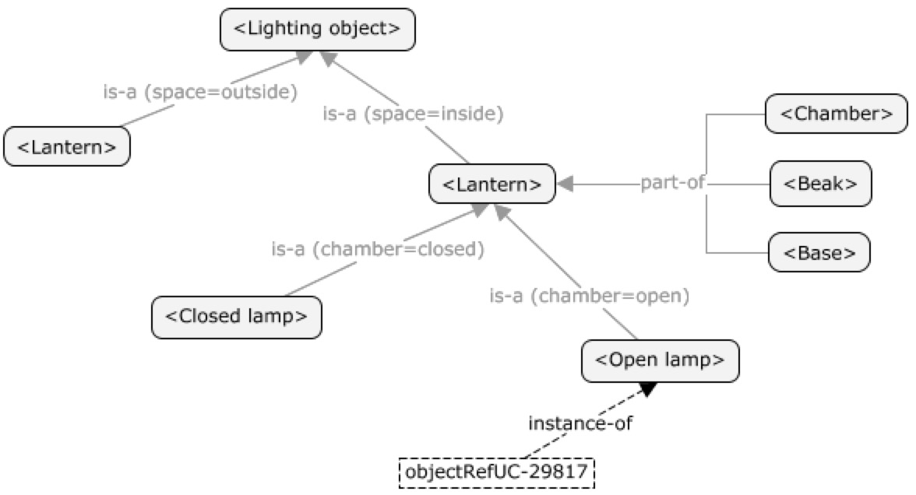
Environnements
ISO 24156

Slide 7
Graphical Tools
CmapTools

Slide 8
Graphical Tool: CmapTools
http://cmap.ihmc.us/
Cmap software is a result of research conducted at the Florida Institute for Human & Machine Cognition (IHMC).
It empowers users to construct, navigate, share and criticize knowledge models represented as concept maps.

Slide 9
CmapTools
Concept maps are graphical tools for organizing and representing knowledge.
They include concepts, usually enclosed in circles or boxes of some type, and relationships between concepts indicated by a connecting line linking two concepts.
Words on the line, referred to as linking words or linking phrases, specify the relationship between the two concepts.
(http://cmap.ihmc.us/docs/theory-of-concept-maps.php)

Slide 10
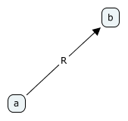
CmapTools
CmapTools
Concept: Concept as a perceived regularity in events or objects, or records of events or objects, designated by a label.
Proposition: Propositions are statements about some object or event in the universe, either naturally occurring or constructed. Propositions contain two or more concepts connected using linking words or phrases to form a meaningful statement.
Concept: Node
Proposition: labeled link

Slide 11
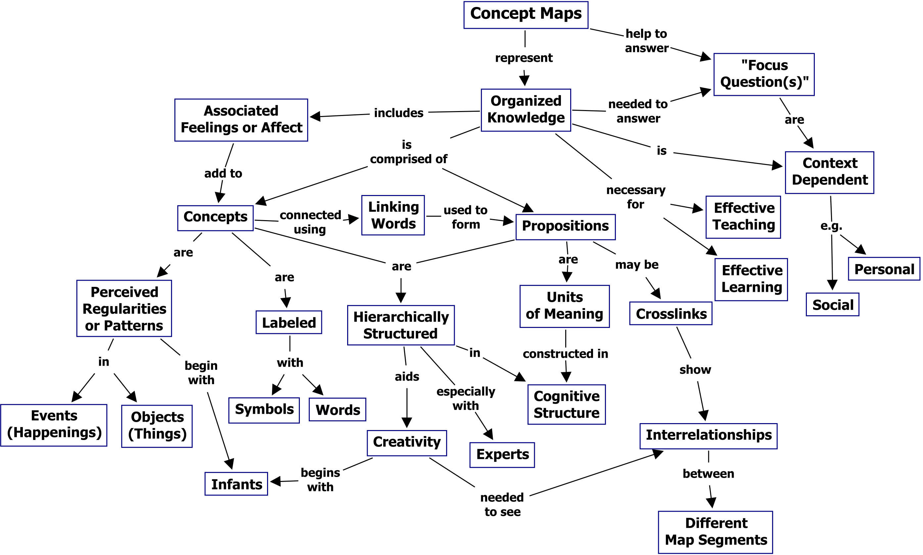
CmapTools

Slide 12
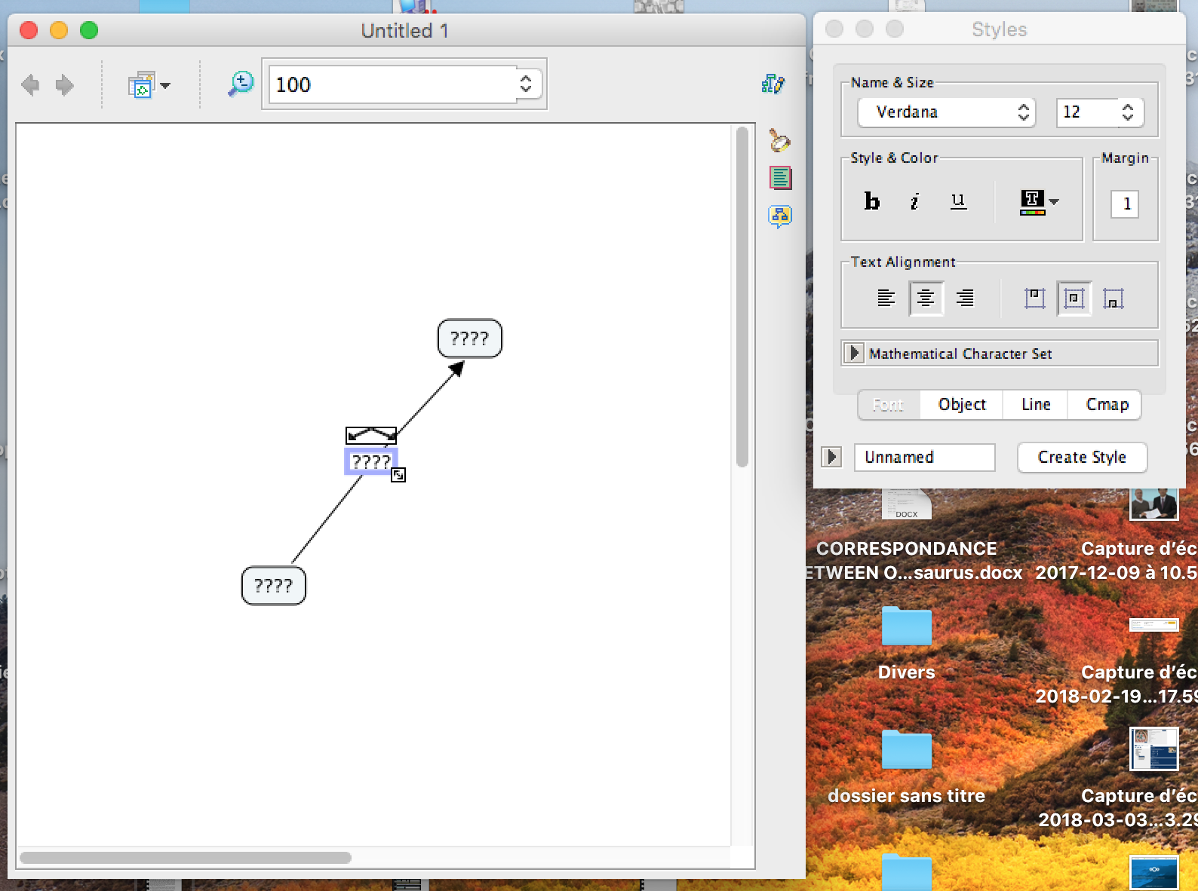
CmapTools
Do it

Slide 13
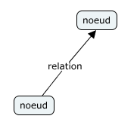
CmapTools
How to Represent the Categories of Thought?
Langue of Intellection
Representation Language
Categories of Thought :
Object
Characteristic : - essential
- descriptive
Concept
Set
Relation : - generic
- partitive
- functonial
- associative
- …….
Language Categories of CmapTools
- Node
- Labelled link (binary relationhips)
Expression

Slide 14
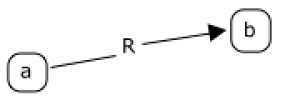
CmapTools
Semiotic code
each category of thought will be represented differently
concept
<Concept>
<Concept>
individual
individual
individual
Essential characteristic
/characteristic/
relations
R(a,b)
Descriptive characteristic
at(e,v)

Slide 15
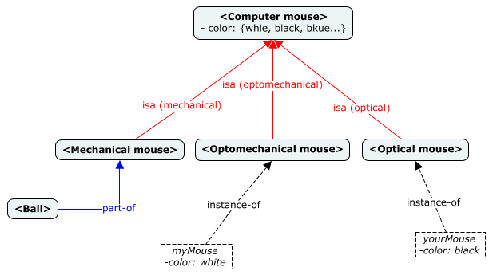
CmapTools
Représentation en Cmap des catégories de pensée ?
Langue de l’intellection
Langue de représentation
Catégories de pensée :
Objet
Caractéristique : - essentielle
- descriptive
Concept
Ensemble
Relation : - générique
- partitive
- fonctionnelle
- associative
- …….
Catégories de langage Cmap :
Code sémiotique
Expression
Aucune vérification

Slide 16
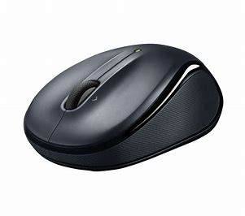
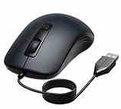
CmapTools
No verification

Slide 17
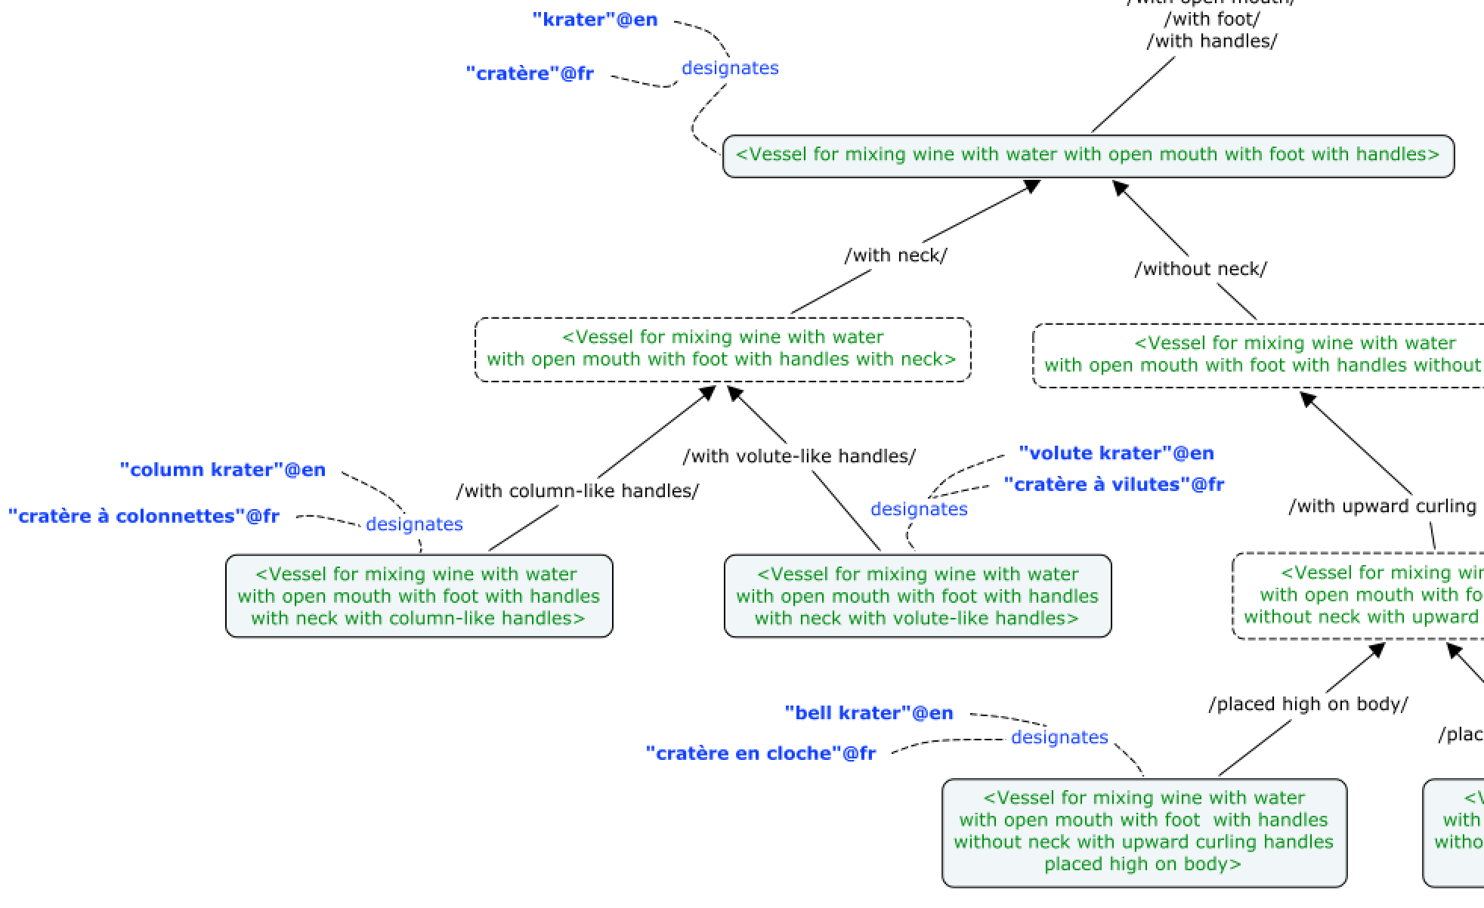
CmapTools
terms
concepts

Slide 18
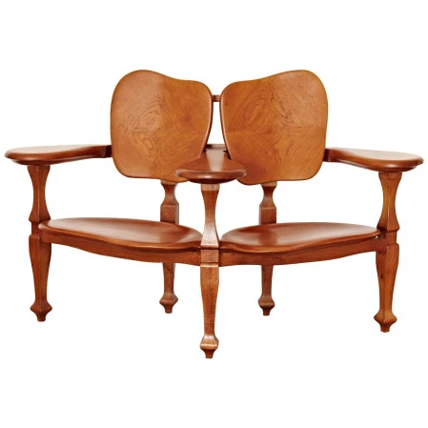
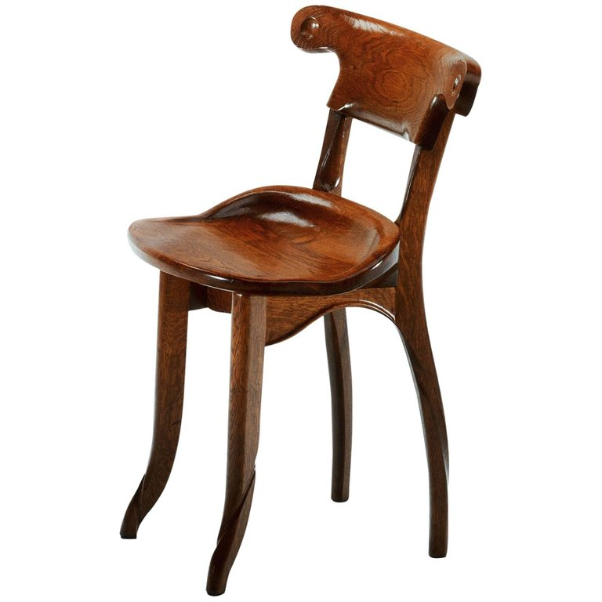
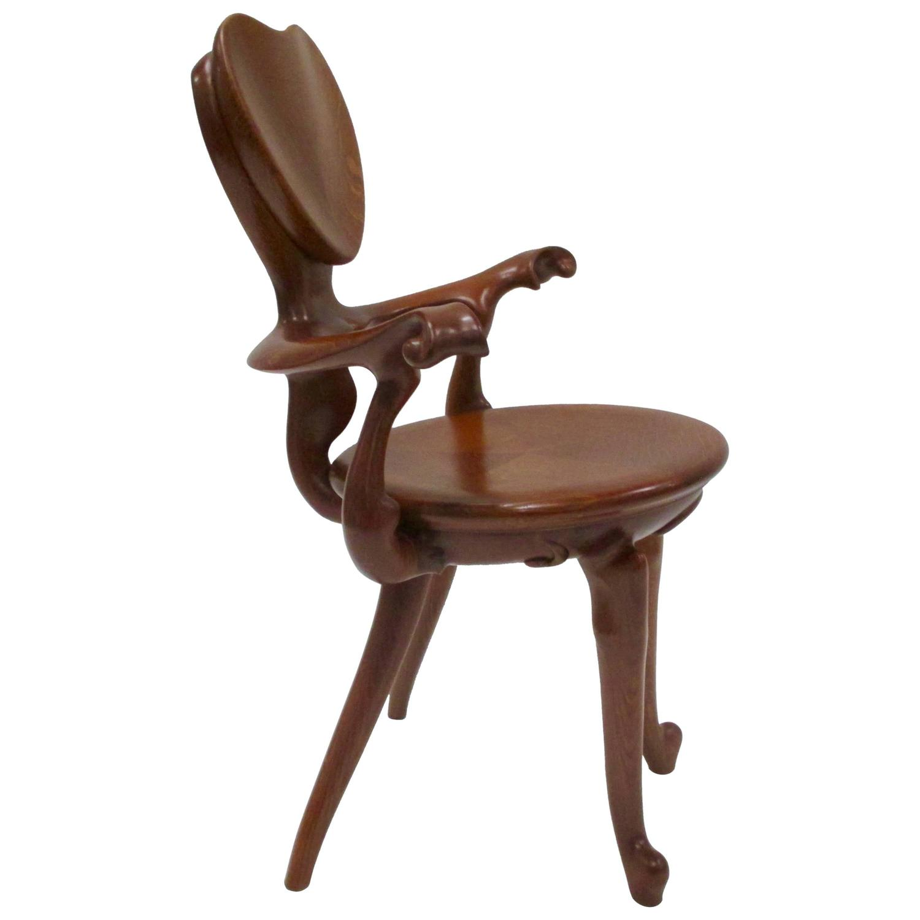
Exercise
椅子
armchair
chaise
fauteuil
pouf
banc
stool
tabouret
长凳
bench
chair
canapé
couch
长椅

Slide 19
Array of Differences
Axis of analysis
Axis of analysis
Axis of analysis
Axis of analysis
Terms
Concepts | for one person | several persons | with feet | without feet | with back | without back | with arms | without arms | Designations (English) | Designations (French)
<Seat 1 person with feet with back without arms> | X |  | X |  | X |  |  | X | “chair” | “chaise”
<Seat 1 person with feet with back with arms> | X |  | X |  | X |  | X |  | “armchair” | “fauteuil”
<Seat 1 person with feet without back without arms> | X |  | X |  |  | X |  | X | “stool” | “tabouret”
<Seat several persons with feet with back with arms> |  | X | X |  | X |  | X |  | “couch” | “canapé”
<Seat several persons with feet without back without arms> |  | X | X |  |  | X |  | X | “bench” | “banc”
Some concepts can have no designation:
in a given language (e.g. the term “椅子" in Chinese designates the concept of <Seat for one person with back and feet>, which has no designation in English (“chair” or “armchair”)
in any languages (e.g. concepts whose purpose is organizing the ontology)

Slide 20
CmapTools

Slide 21
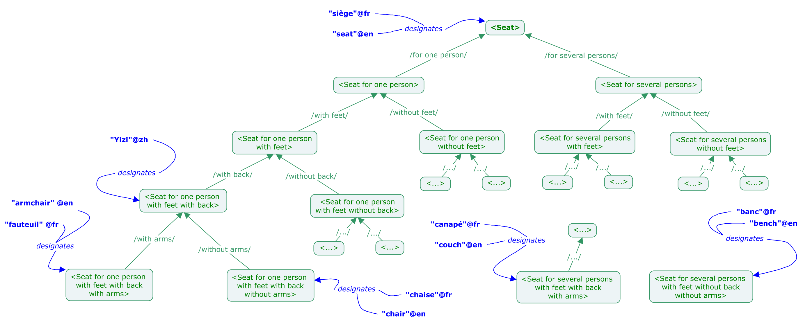
Exercise: CmapTools

Slide 22
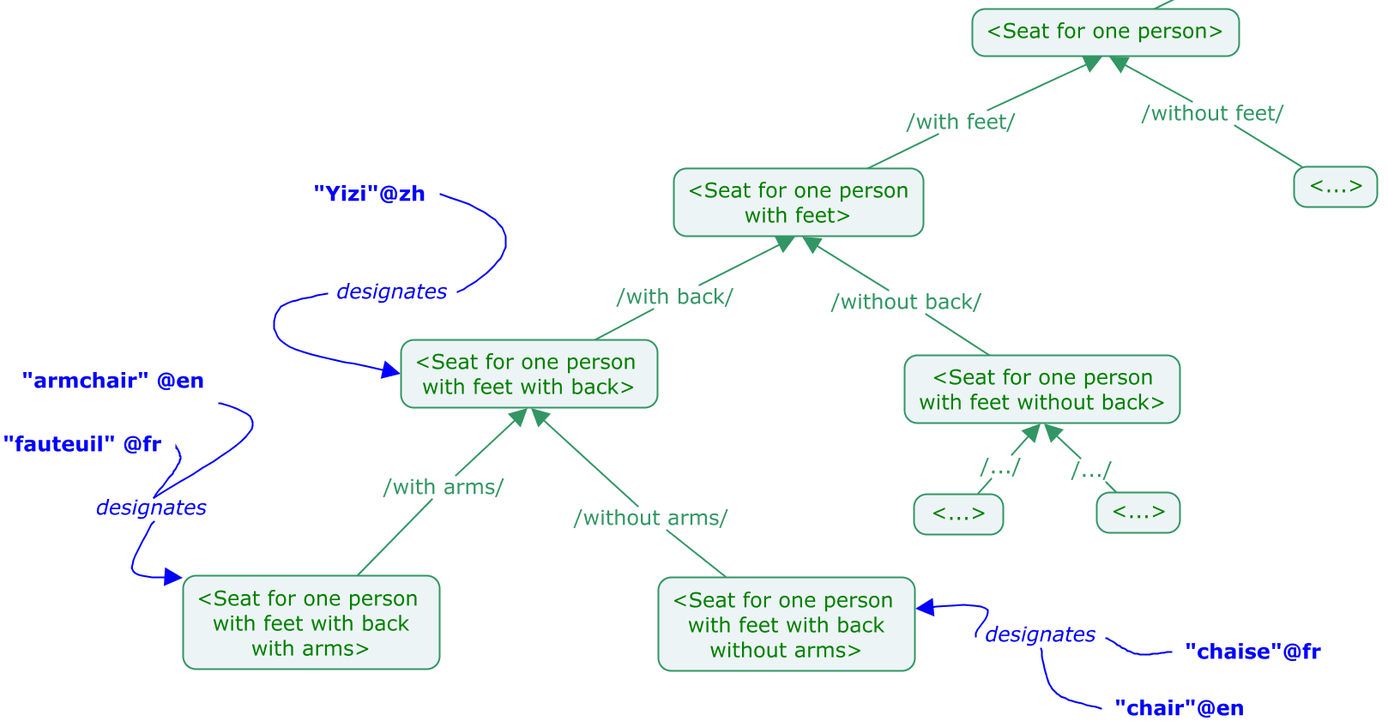
Exercise: CmapTools

Slide 23
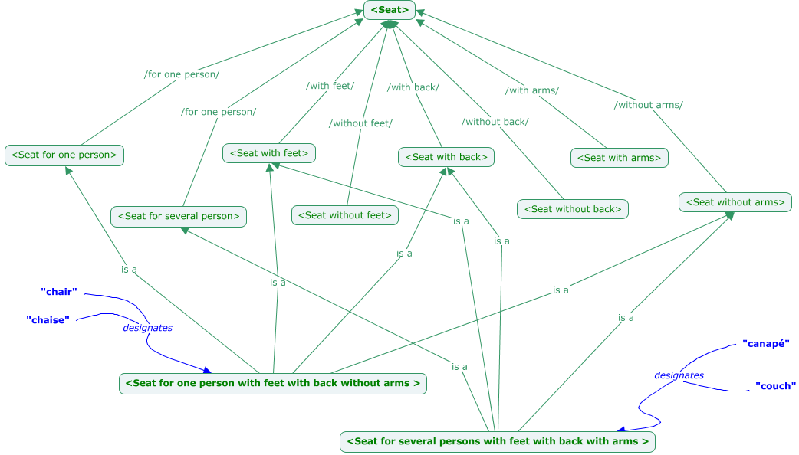
Exercise: CmapTools

Slide 24
Formal Tools
Protégé

Slide 25
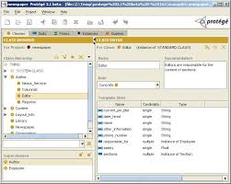
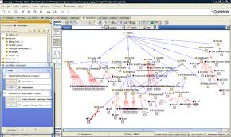
Protégé is a free, open source ontology editor written in Java and developed at Stanford University. More than 300,000 users are registered.
It provides:
a graphic user interface to define ontologies;
deductive classifiers to validate that models are consistent and to infer new information based on the analysis of ontology.

Slide 26
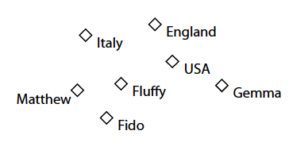
Components of OWL Ontologies
1) Individuals
Individuals, represent objects in the domain in which we are interested
Terminology: « individual » or « instance »

Slide 27
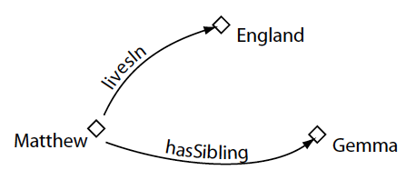
Components of OWL Ontologies
2) Properties
Properties are binary relations on individuals, i.e. properties link two individuals together.
Terminology: « properties », « slots » (Protégé), « roles » (DL), « relations », « attributes »

Slide 28
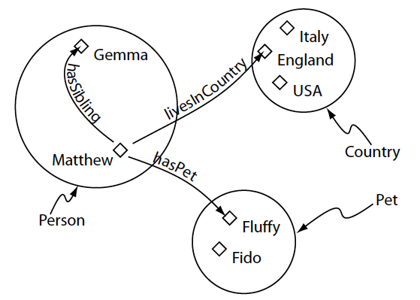
Components of OWL Ontologies
3) Classes
OWL classes are interpreted as sets that contain individuals.
Classes can be declared as disjoint
Terminology: « classes », « concepts »

Slide 29
Components of OWL Ontologies
5) Reasoner
Inconsistent classes
Terminology: « classes », « concepts »

Slide 30
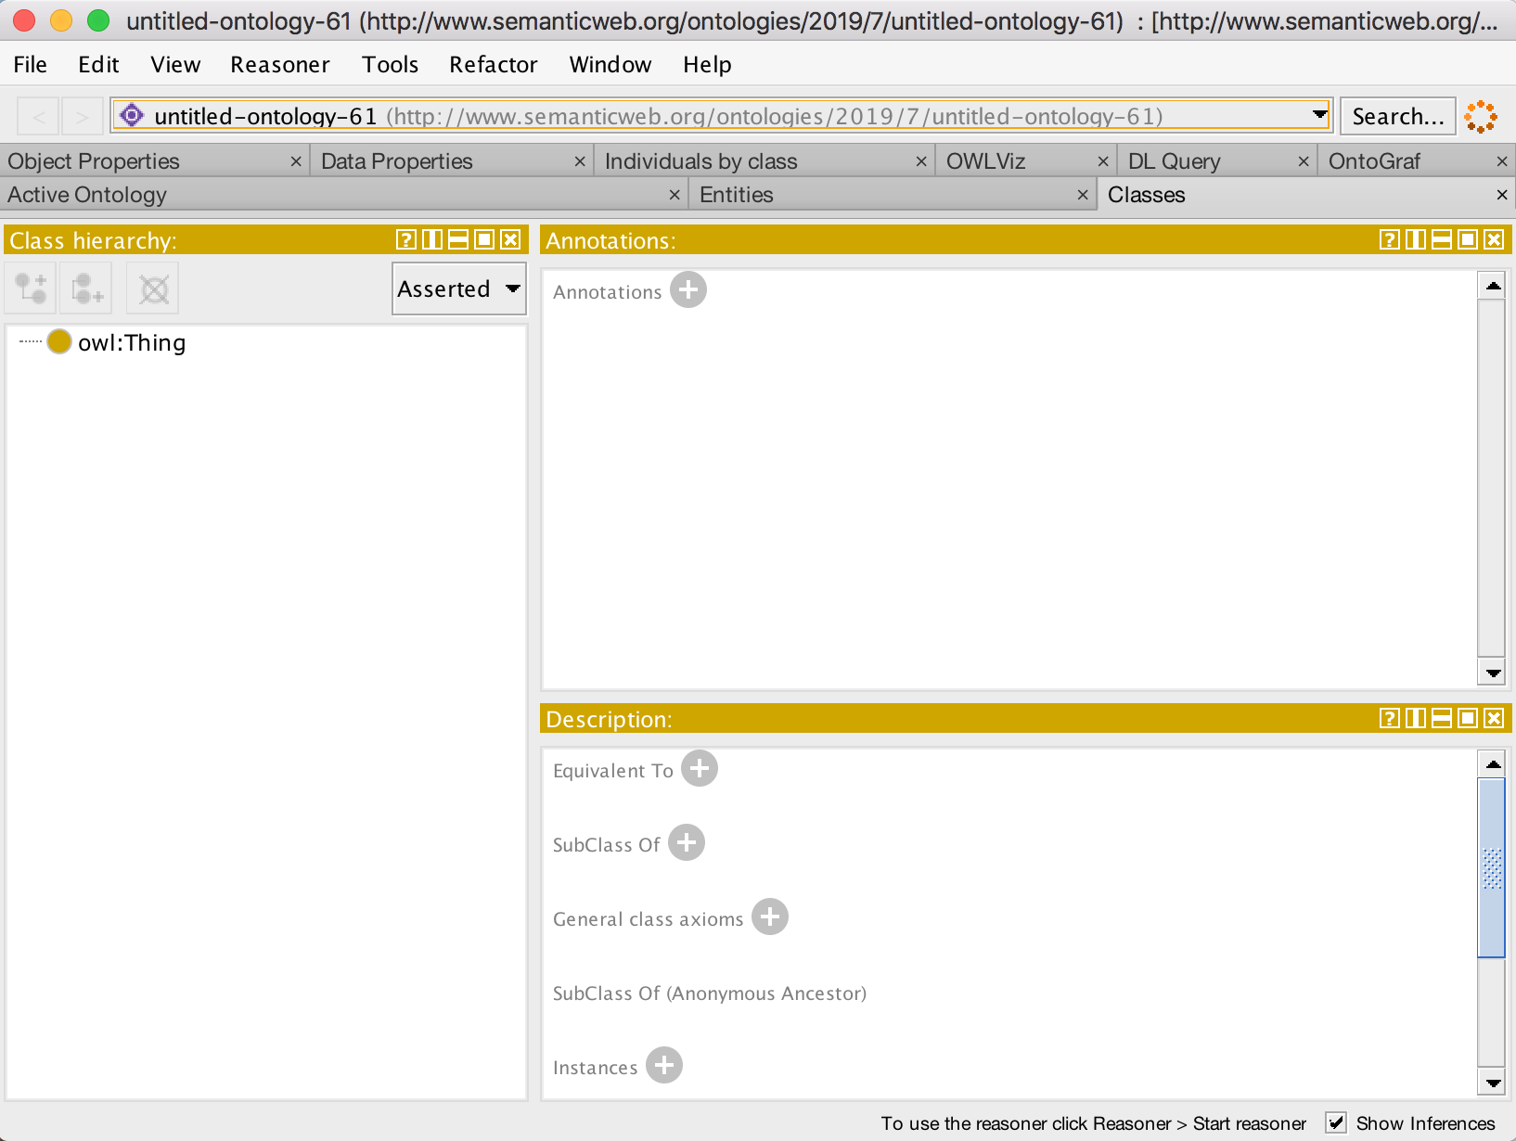
Do it

Slide 31
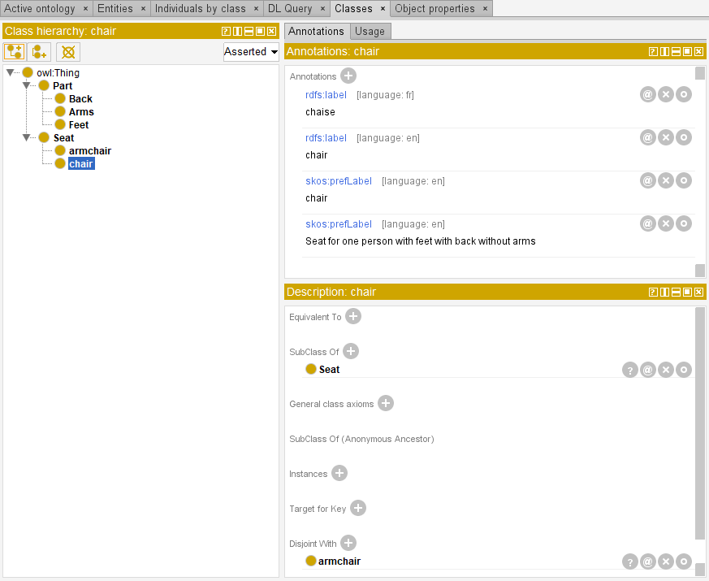
Class Hierarchy

Slide 32
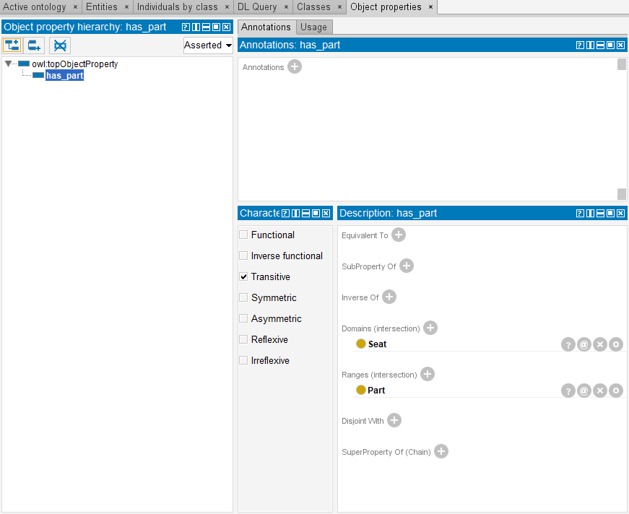
Object Property Hierarchy

Slide 33
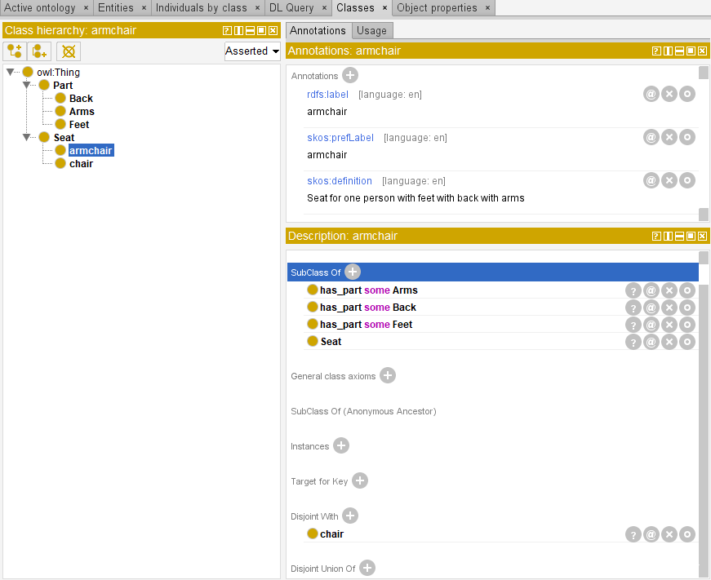
Class Hierarchy

Slide 34
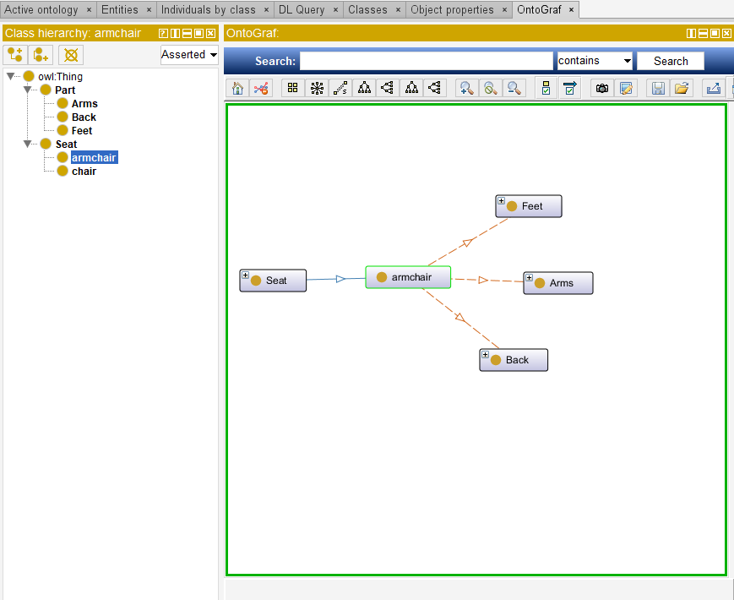
Visualization

Slide 35
Exercise
椅子
armchair
chaise
fauteuil
pouf
banc
stool
tabouret
长凳
bench
chair
canapé
couch
长椅

Slide 36
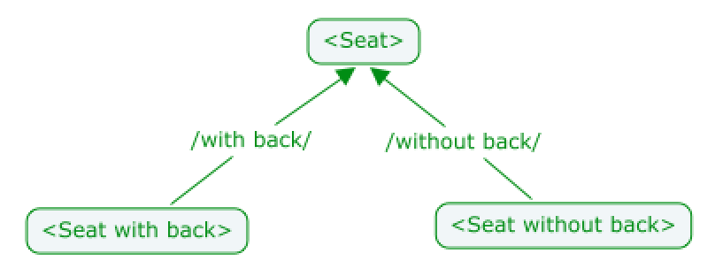
How to represent an essential characteristic?
Back
hasPart
Seat
hasPart
hasPart
hasPart
Seat with back
hasPart
Seat for one person?
Seat without back?

Slide 37
Exercise
Seat with feet
Seat for one person
Seat for with back
Seat without arms

Slide 38
Dedicated Tools

Slide 39
Tedi : ontoTerminology editor
A Tool-Based Method
Ontoterminology: Terminology whose conceptual system is a formal ontology
www.ontoterminology.com

Slide 40
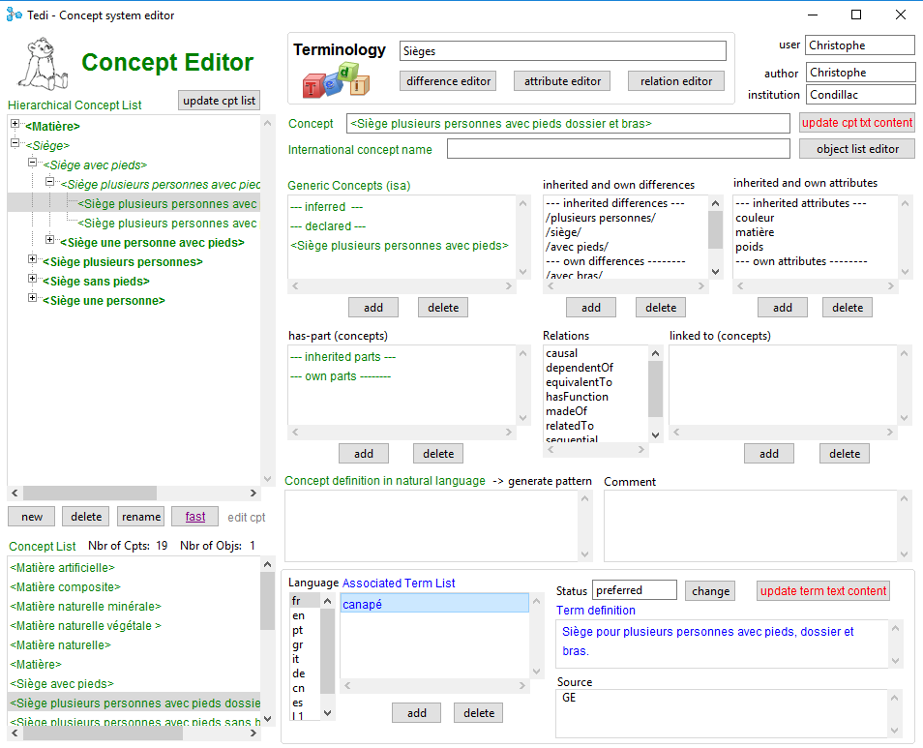
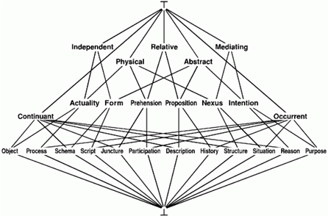
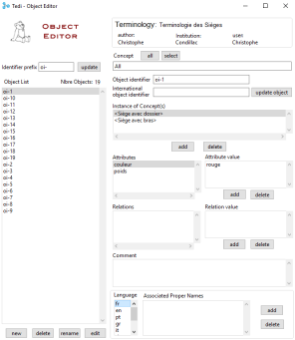
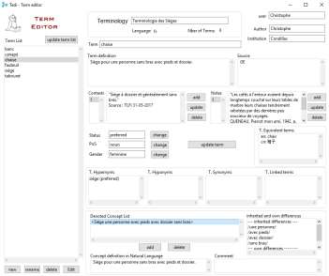
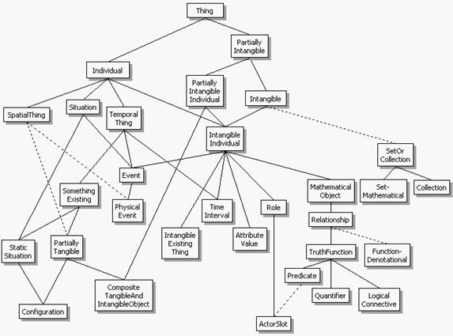
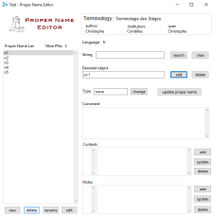
Ontoterminology Editor
○
Set of dedicated editors
Concept editor
- multilingualism
- linguistic diversity
- operationalisation
Shared Ontology
Object editor
Term editor
Term Editor
Multilingual Terminologies
Proper names editor
Proper names editor

Slide 41
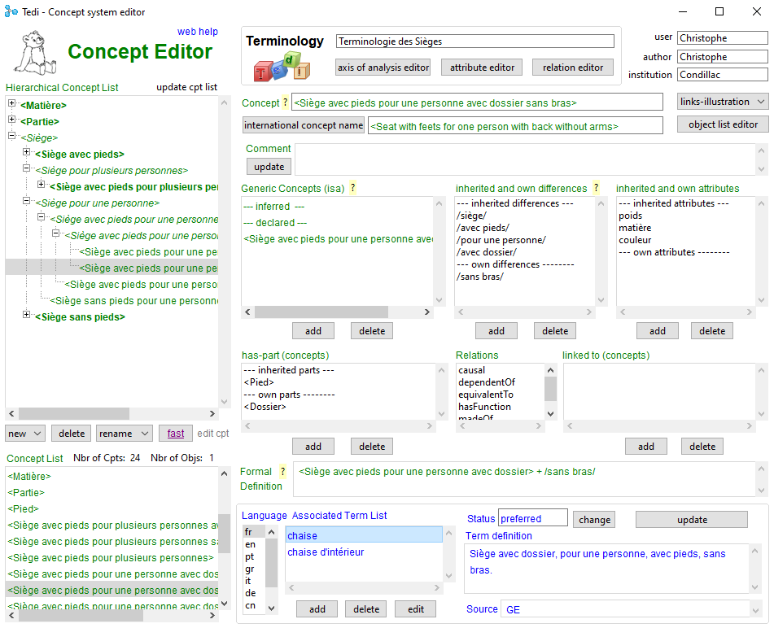
Ontoterminology Editor

Slide 42
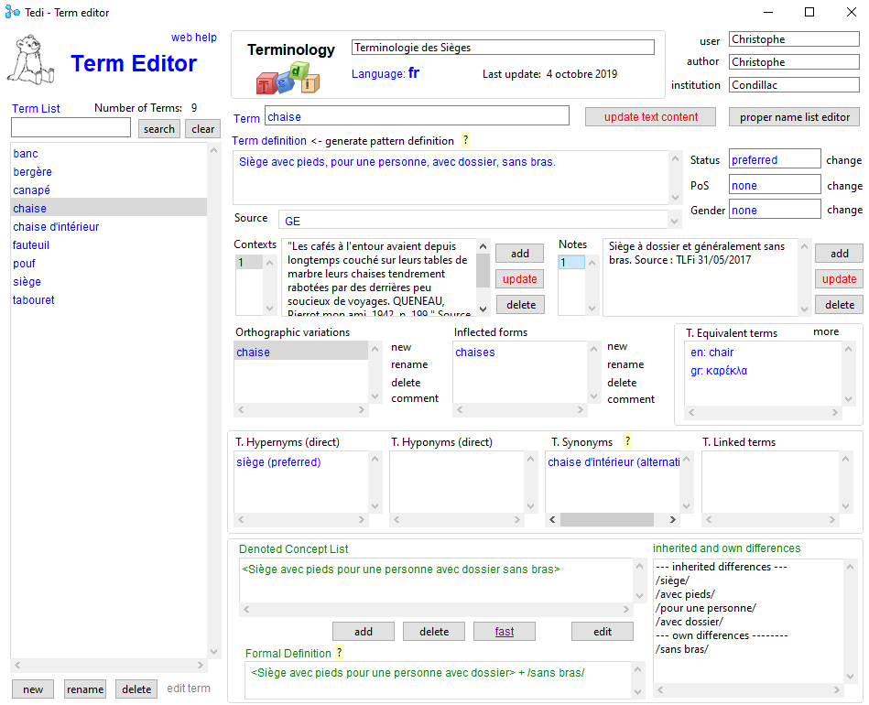
Ontoterminology Editor

Slide 43
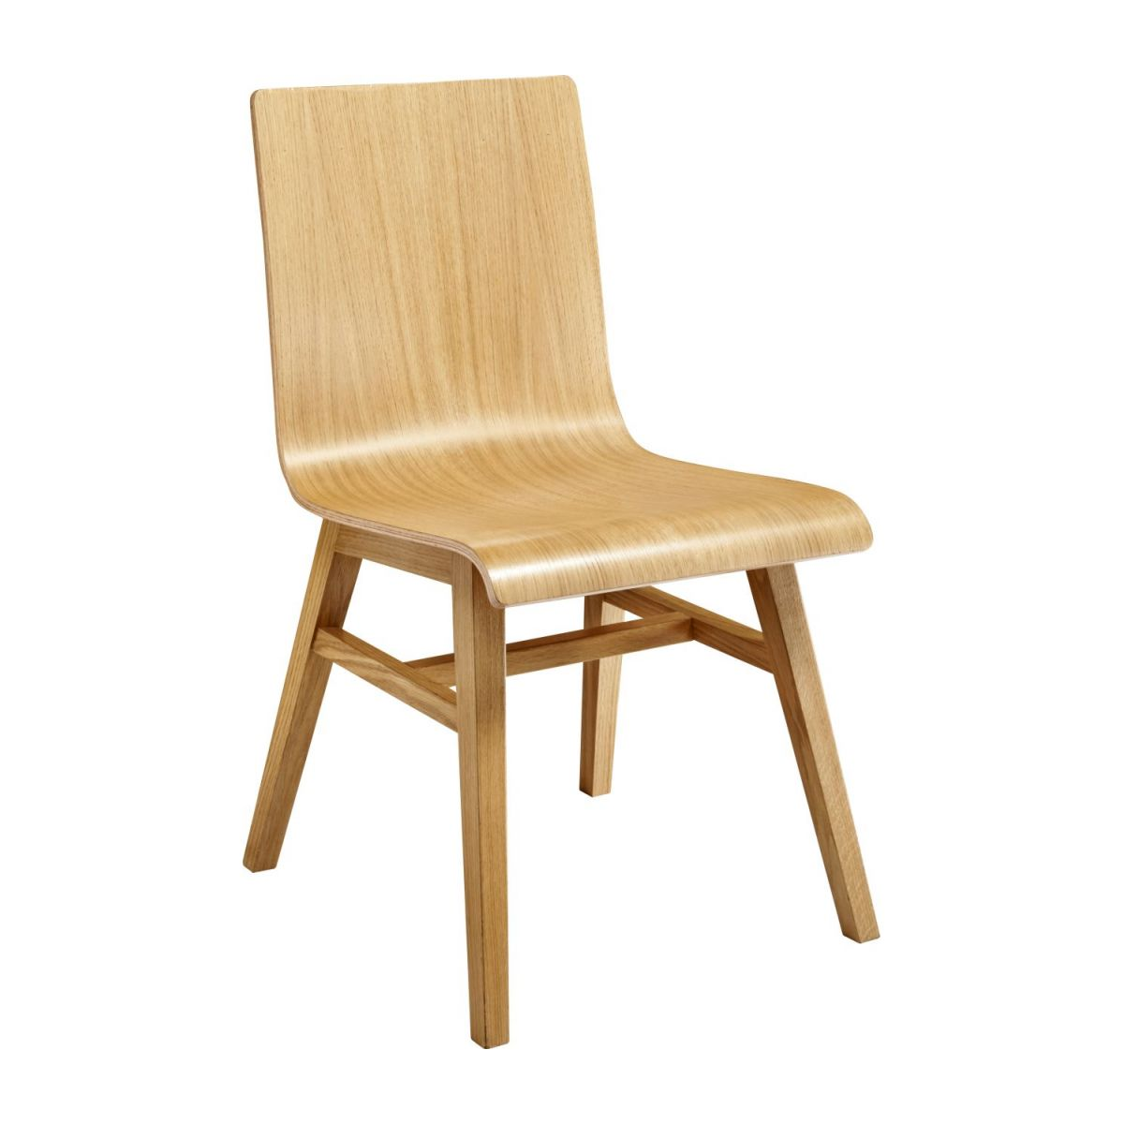
Ontoterminology Editor
term
definition of the term in natural language
“chair”
:
“Seat for one person, without arms, with back, with feet.”
designates
“siège” (preferred term)
Linguistic Dimension
is designated by
concept
Conceptual Dimension
pattern generation
<Seat one person without arms with back with feet>
definition of the concept in a formal language
<Seat>
+ /for one person/
+ /without arms/
+ /with back/
+ /with feet/
::=

Slide 45
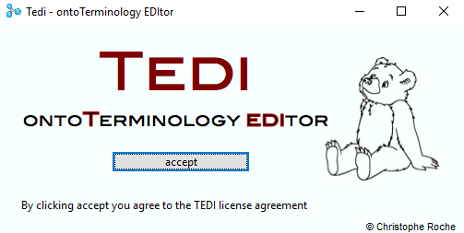
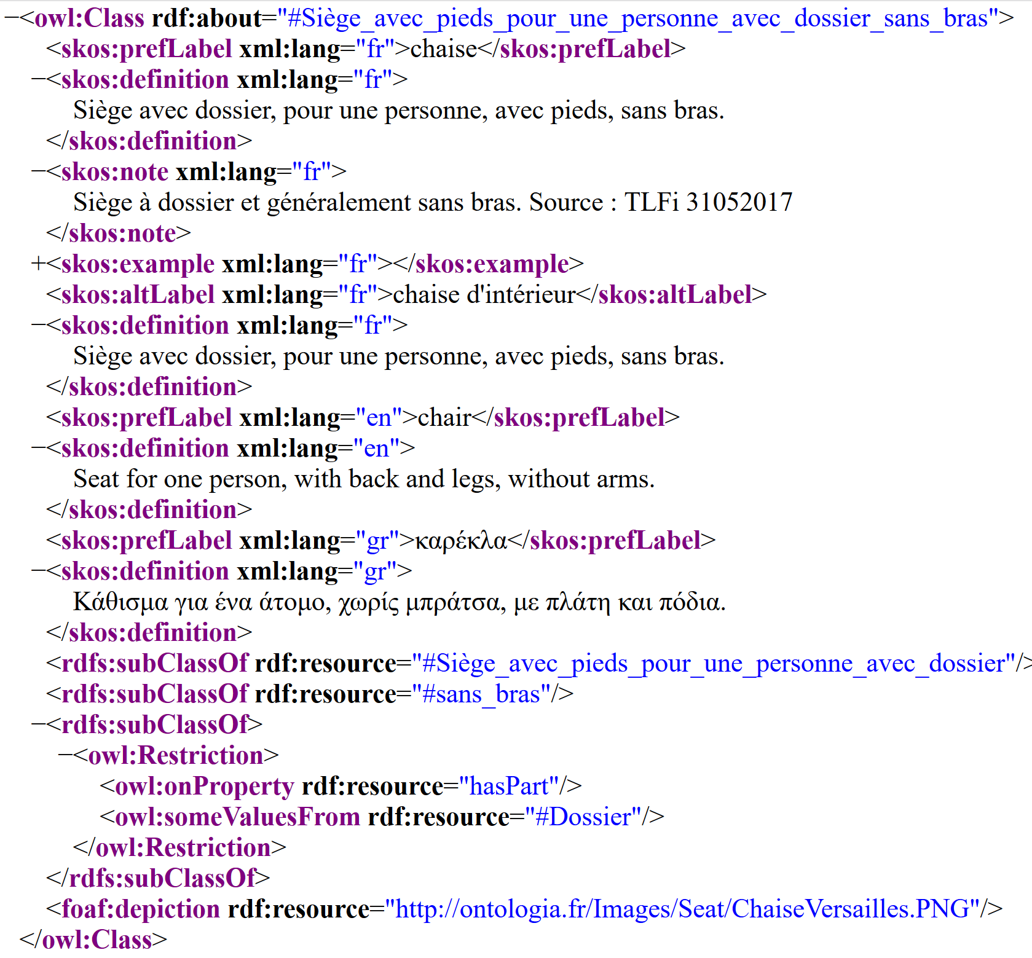
The Ontoterminology
Process
1
RDF Export
2
3
Protégé

Slide 46
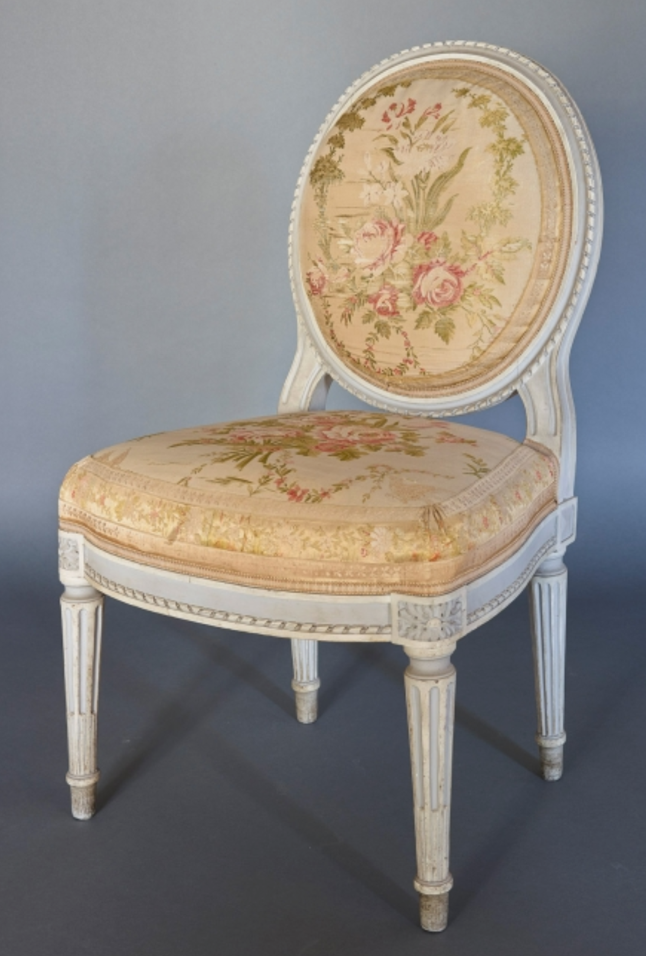
Ontoterminology of Seats
https://data.bnf.fr/current/sparql.html
http://ontologia.fr/OTB/Sieges.owl
SELECT ?name ?definition ?img
WHERE {
?concept rdf:type owl:Class.
?concept skos:prefLabel ?name.
?concept skos:definition ?definition.
?concept foaf:depiction ?img.
FILTER (lang(?name) = 'gr').
FILTER (lang(?definition) = ‘gr’)
}

