Slide 1
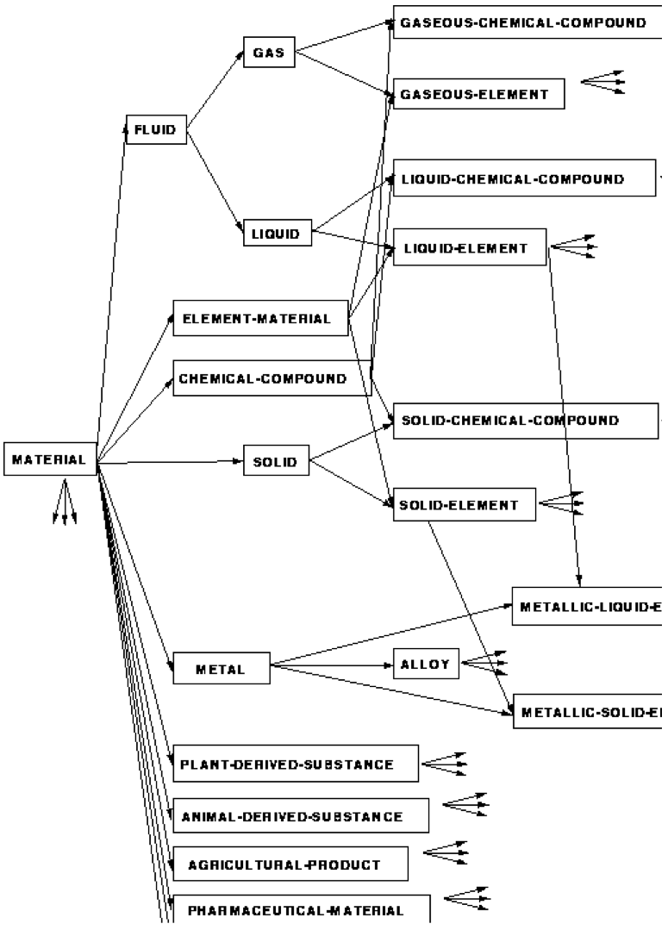
Part 5: Ontology

Slide 2
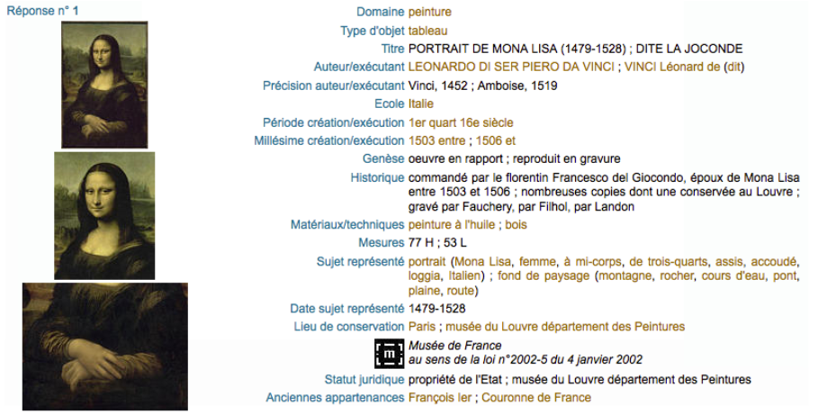
Vocabularies – Ontologies – Terminologies
Vocabulary
Terminology
Ontology
Vocabulary
Terminology
Ontology
Properties
Values

Slide 3
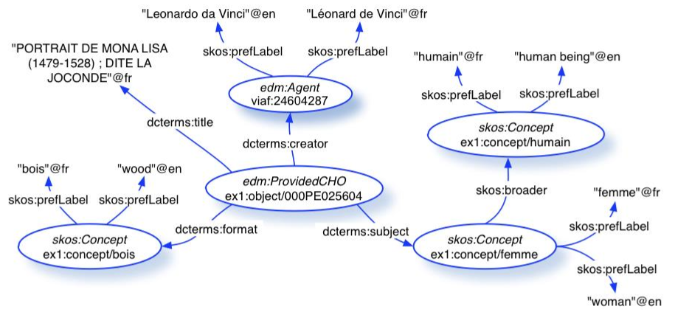
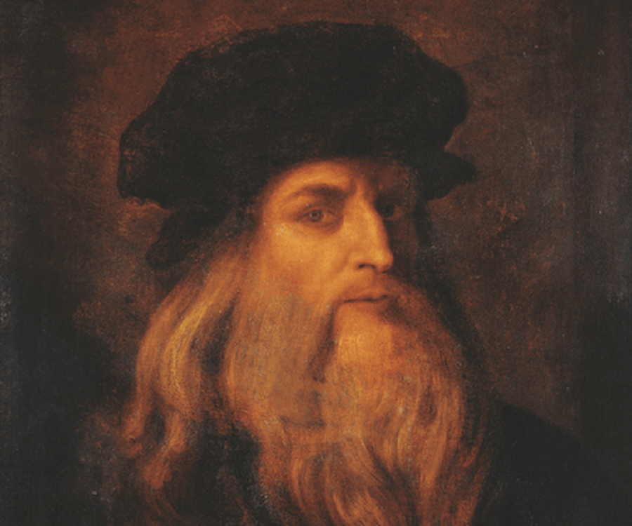
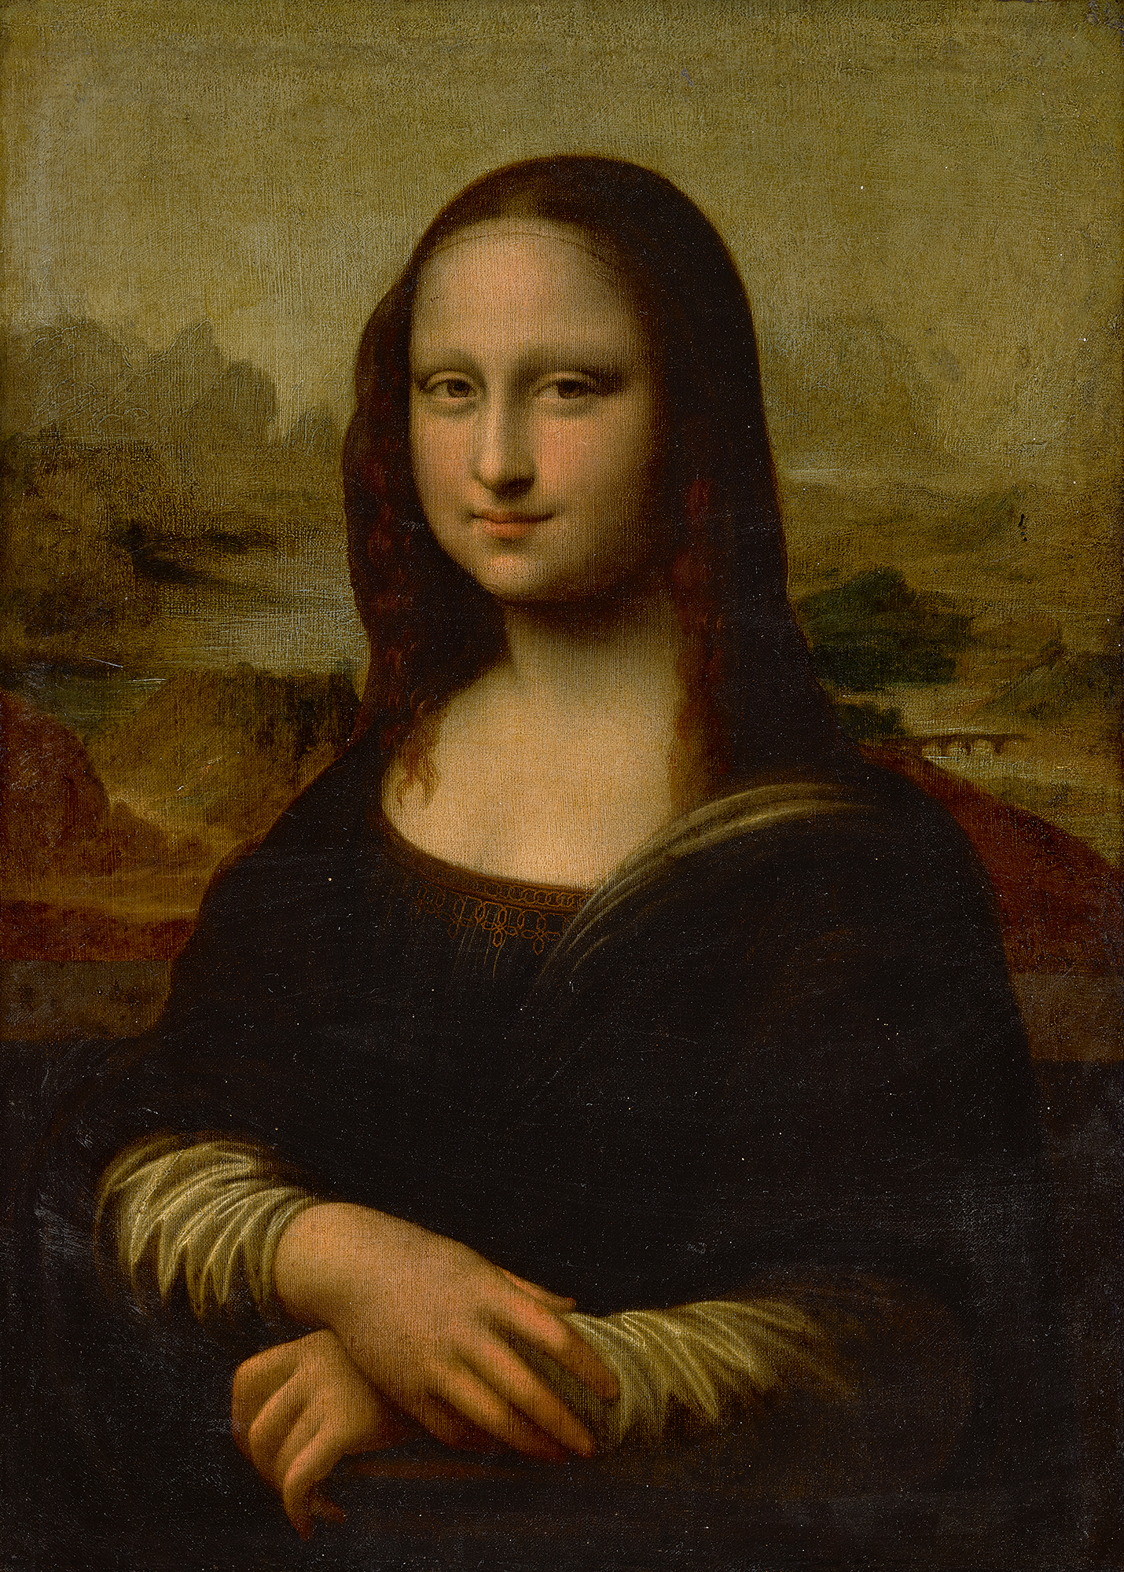
Vocabularies – Ontologies – Terminologies
Ontologies
Vocabularies
Concepts
Relations
Human
subclass
subclass
Man
Woman
Material
subclass
subclass
Wood
Metal

Slide 4
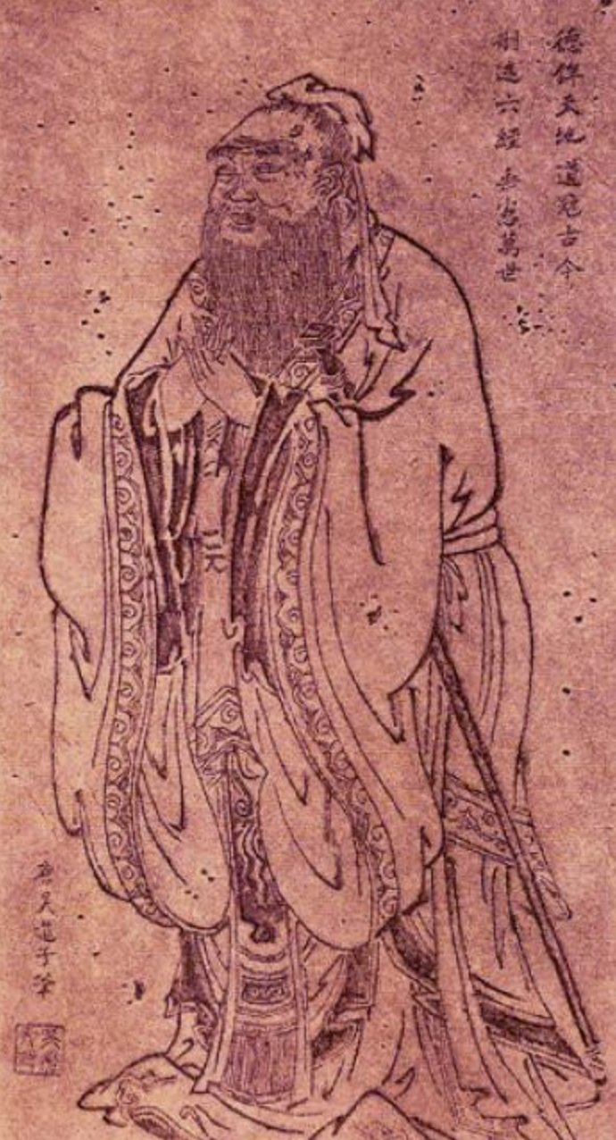
DBpedia Query
https://dbpedia.org/sparql
SELECT distinct ?person
WHERE {
?person rdf:type dbo:Person.
?person rdfs:label "Confucius"@en.
}
limit 100

Slide 5
DBpedia Query
rdf:type | owl:Thing foaf:Person dbo:Person dul:Agent dul:NaturalPerson wikidata:Q215627 wikidata:Q24229398 wikidata:Q4964182 wikidata:Q5 dbo:Agent dbo:Philosopher schema:Person umbel-rc:PersonWithOccupation umbel-rc:Philosopher yago:WikicatGuqinPlayers yago:CausalAgent100007347 yago:Communicator109610660 yago:Contestant109613191 yago:Historian110177150 yago:Humanist110191192 yago:Intellectual109621545 yago:LivingThing100004258 yago:Object100002684 yago:Organism100004475 yago:Person100007846 yago:Philosopher110423589 yago:PhysicalEntity100001930 yago:Player110439851 yago:Scholar110557854 yago:Whole100003553 yago:Writer110794014 yago:YagoLegalActor yago:YagoLegalActorGeo yago:WikicatChinesePhilosophers yago:WikicatChineseWriters yago:WikicatClassicalHumanists yago:Wikicat5th-centuryBCHistorians yago:Wikicat5th-centuryBCPhilosophers yago:Wikicat5th-centuryPhilosophers yago:Wikicat6th-centuryBCPhilosophers yago:Wikicat6th-centuryChinesePeople yago:WikicatAncientChinesePhilosophers yago:WikicatWritersFromShandong yago:WikicatZhouDynastyHistorians yago:WikicatMoralPhilosophers yago:WikicatPeopleFromQufu yago:WikicatPoliticalPhilosophers
http://dbpedia.org/page/Confucius
owl:sameAs | wikidata:Confucius dbpedia-cs:Confucius dbpedia-de:Confucius dbpedia-el:Confucius dbpedia-es:Confucius dbpedia-eu:Confucius dbpedia-fr:Confucius dbpedia-id:Confucius dbpedia-it:Confucius dbpedia-ja:Confucius dbpedia-ko:Confucius dbpedia-nl:Confucius dbpedia-pl:Confucius dbpedia-pt:Confucius dbpedia-wikidata:Confucius http://viaf.org/viaf/89664672 http://www4.wiwiss.fu-berlin.de/gutendata/resource/people/Confucius_551_BC-479_BC http://sw.cyc.com/concept/Mx4r_k-Y9SNjQYOm5JVvJX8_ug freebase:Confucius yago-res:Confucius http://d-nb.info/gnd/118565036

Slide 6
Ontology
“Ontologies are used to capture knowledge about some domain of interest. An ontology describes the concepts in the domain and also the relationships that hold between those concepts. Different ontology languages provide different facilities”
“Practical Guide to Building OWL Ontologies Using Protégé 4 and CO-ODE Tools” Edition 1.3 MattheA w Horridge
“On the Semantic Web, vocabularies define the concepts and relationships (also referred to as “terms”) used to describe and represent an area of concern. Vocabularies are used to classify the terms that can be used in a particular application, characterize possible relationships, and define possible constraints on using those terms.”
“There is no clear division between what is referred to as “vocabularies” and “ontologies”.”

Slide 7
Ontology
1) An Ontology is a Specification of a Conceptualization
i.e. a definition in a computer-understandable language of concepts and relationships between concepts.
2) An Ontology is a Terminology whose terms are formally defined

Slide 8
Questions
✓ What is a concept?
✓ What is the use of it?
✓ What is a term?
✓ What is the use of it?

Slide 9
■ Concept
What is a concept for?
✓ Understanding the World
✓ Organizing the objects
Gathering objects
sharing the same properties

Slide 10
■ Concept
A concept is a unit of knowledge about a plurality of things
A concept is a unique combination of essential characteristics (ISO 1087, ISO 704)
/1person/
/with feet/
/with back/
shared characteristics
delimiting characteristics
/with arms/
/without arms/
/soft/

Slide 11
■ Term
A term is a verbal designation of a concept (ISO 1087, 704)
Often reduced to a label on a concept (rdfs:label , skos:prefLabel)

Slide 12
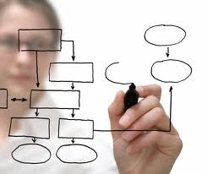
Definition & Representation of a Concept
Which system-language?
✓ Concept Modelling
➥ epistemological principles
✓ Objective Definition
➥ formal language
✓ Operationalisation
➥ computational representation: ontology

Slide 13
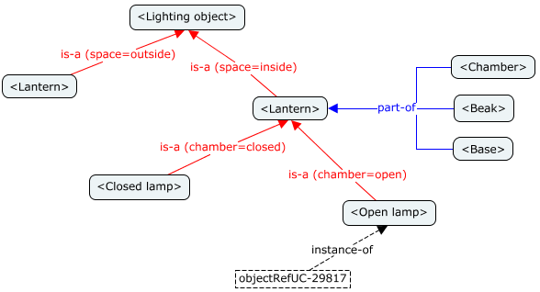
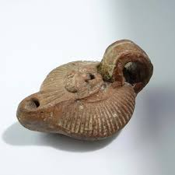
Graphical Notation
✓ Easy to use
✓ Human Readable
<Lamp>
✓ Semi-Formal
Categories of thought?
Methodology?
Coherency?
Operationalization?

Slide 14
Artificial Intelligence
Schema (Frame) - Minsky
Describe the structure of objects
A class is defined as a set of slots with values
(defun-class lamp
(is-a ‘lighting-object)
(space ‘inside)
(has-part ‘chamber ‘beak ‘base))
Clear, powerful, readable both by human and computer

Slide 15
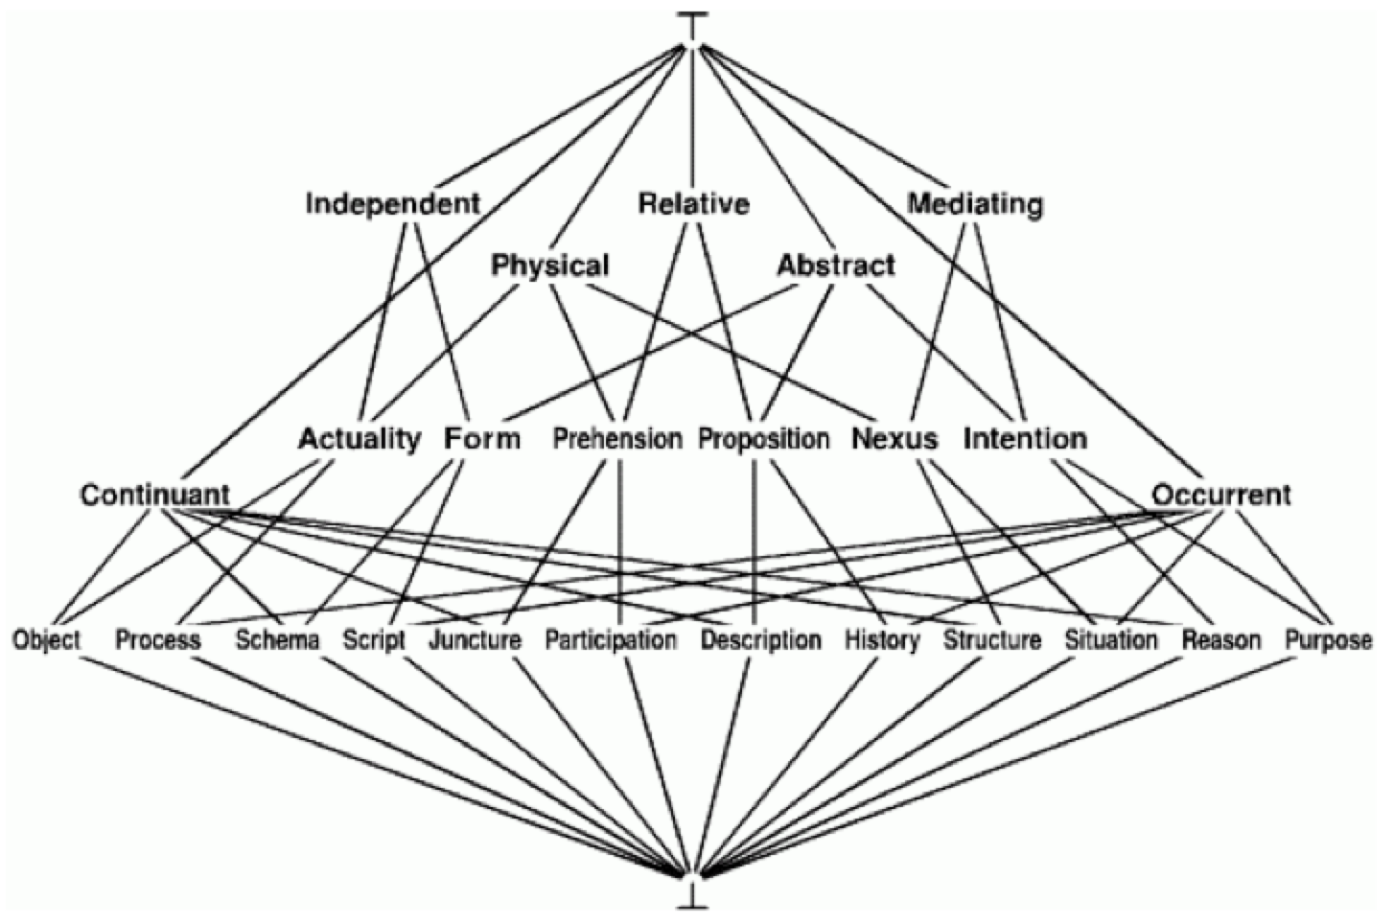
Formal Language
Syntax and Semantics:
✓ Clear
✓ Precise
✓ Formally specified
A concept (category) is an unary predicate.
‘form(x)’ = independant(x) ∧ abstract(x)
Properties of Axiomatic System
Definitions are:
- Objective - Consensual - Readable (for an expert)
- Coherent - Reusable
- Precise - Sharable

Slide 16
Which Language?
✗ The expression of knowledge is limited to the well formed formulas of the theory
✗ The formal languages are not equivalent
The Sapir-Whorf’s hypothesis is true for all languages
☞ Use a language whose categories of language support the categories of thought
☞ Use a formal and computer-readable language
✓ Objective definitions
✓ Constructive definitions
✓ Operationalization

Slide 17
■ Examples of “Universal” Ontologies
Upper Cyc
Mikrokosmos
KR Sowa

Slide 18
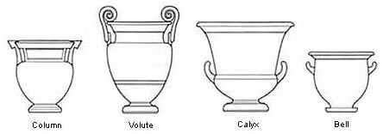
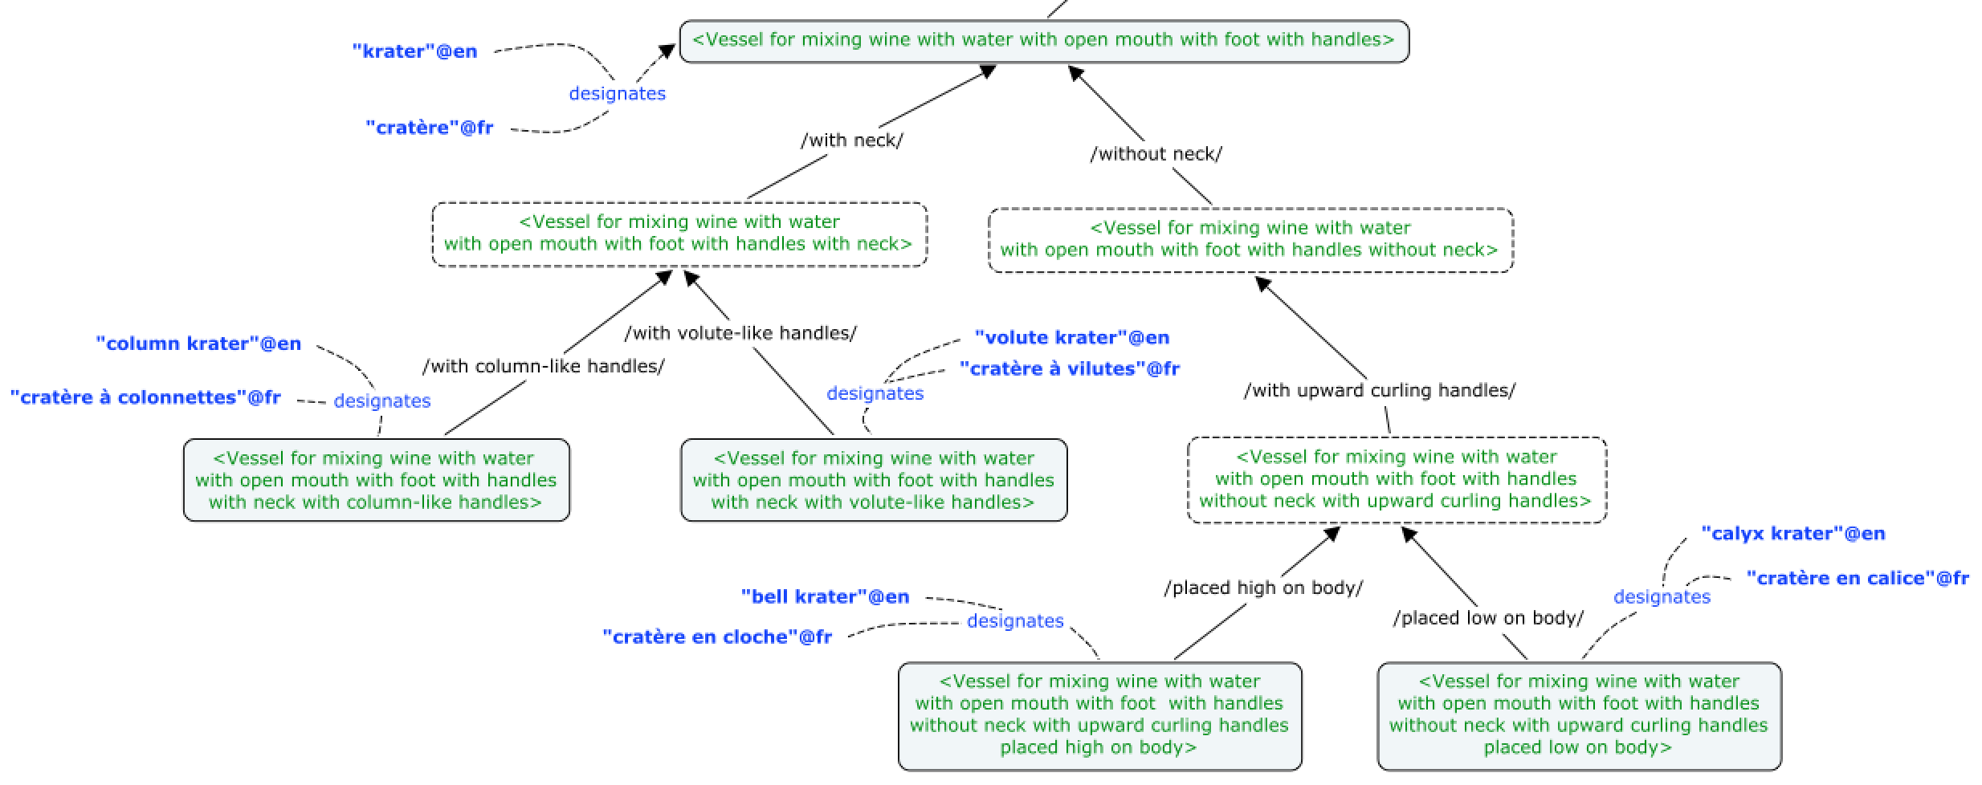
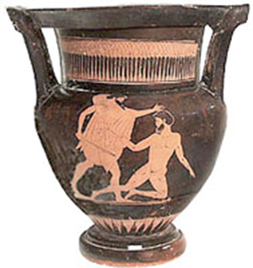
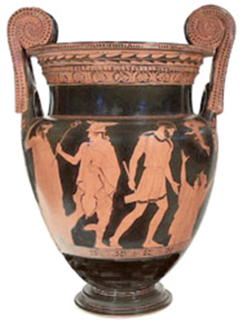
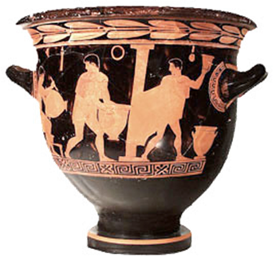
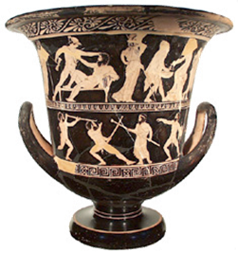
■ Example of a Domain Ontology

