Slide 1
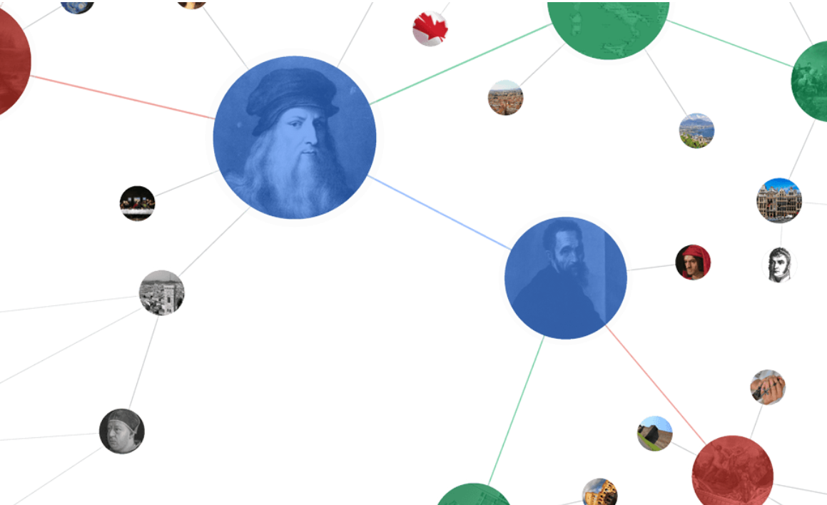
Part 4: Knowledge Graph

Slide 2
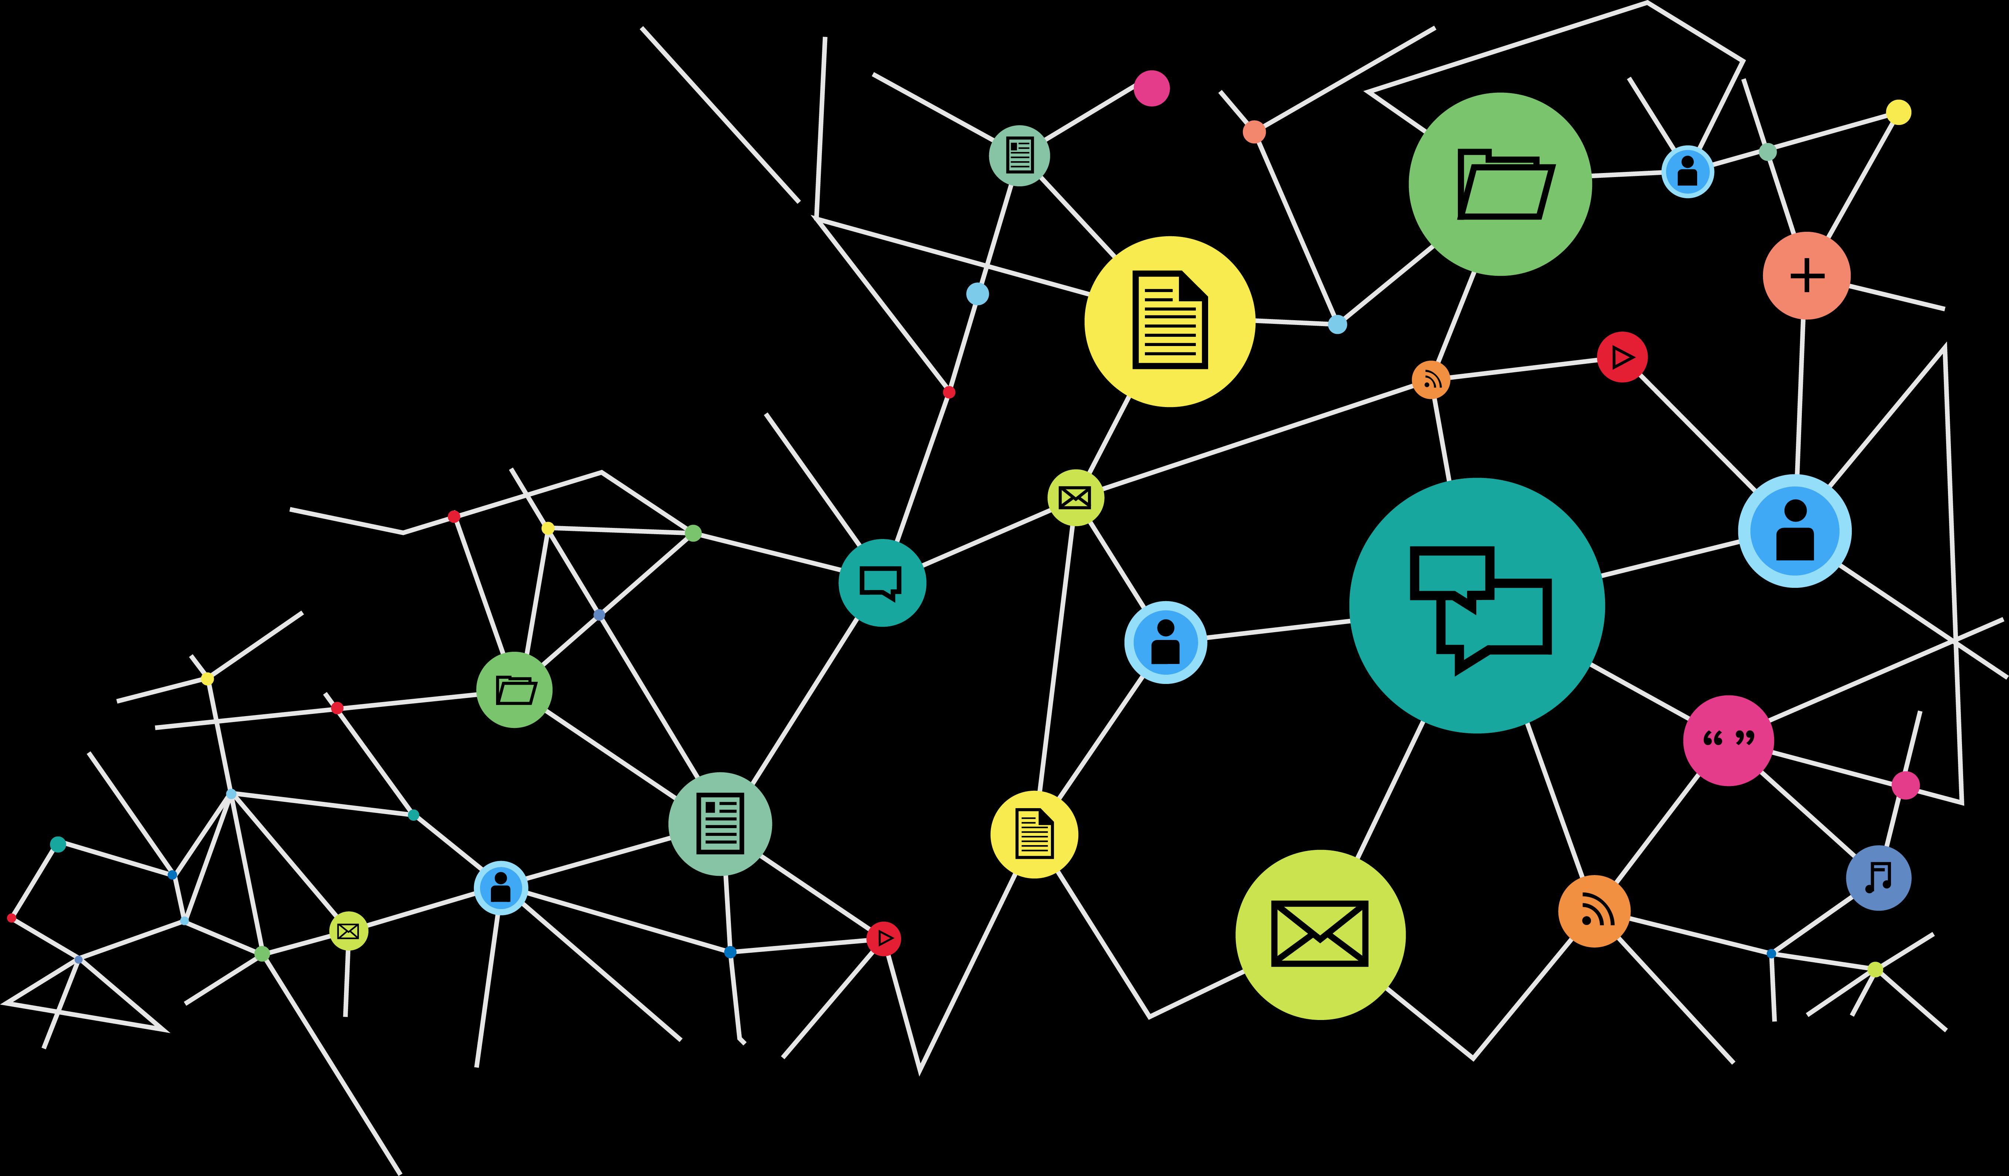
Knowledge Graph
A knowledge graph is a special kind of database which stores knowledge in a machine-readable form and provides a means for information to be collected, organised, shared, searched and utilised.
Main Issues:
Representing Data?
Linking Data?
Searching Data?

Slide 3
Building the Knowledge Graph
Main Issues:
Representing Data?
Linking Data?
Searching Data?

Slide 4
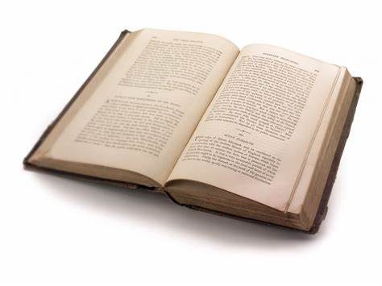
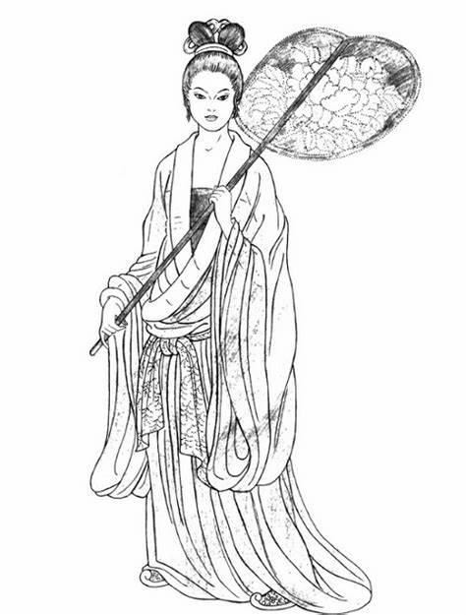
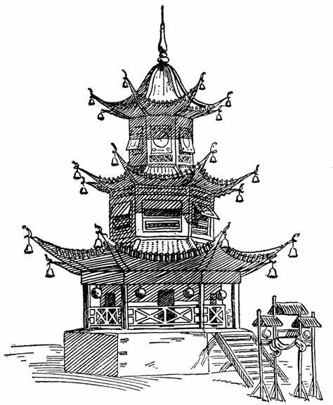
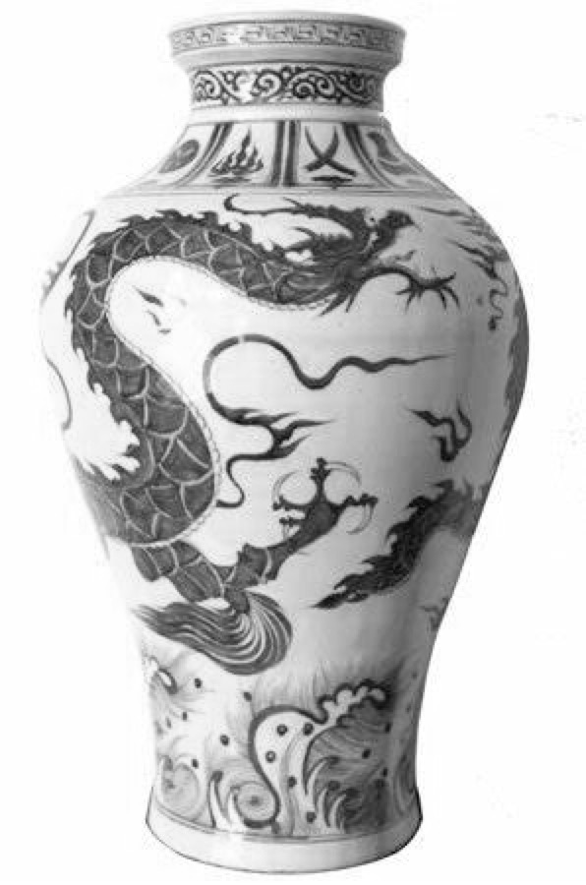
Knowledge Graph
- author
- title
- ISBN
-…
✓ A model for publishing data on the web
✓ Resource
Everything and anything to which we can make reference: a web page, a product, a service, a video…
Everything that can be identified by means of a URI
URI: A Uniform Resource Identifier is a string of characters that unambiguously identifies a particular resource on the Web

Slide 5
Knowledge Graph
✓ Linked data
Through descriptions: relations among resources
Description: Triple ( subject , predicate , object )
Predicate
subject
object
Ex : John is 24
age
John
24

Slide 6
Knowledge Graph
✓ Linked data
Description : Triple ( subject , predicate , object )
Predicate
subject
object
Ex : Duhem wrote a book on the theory of physics in 2007
Predicates : Text (“The theory of physics”)
Creator (“The theory of physics”, Duhem)
Date (“The theory of physics”, 2007)
Subject (“The theory of physics” , Physics)
Triples : (“The theory of physics” , type , Text)
(“The theory of physics” , creator , Duhem)
(“The theory of physics” , date , 2007)
(“The theory of physics” , subject , Physique)
Do it!

Slide 7
Knowledge Graph
Graph
type
Text
Duhem
The theory of physics
creator
subject
Physics
date
2007

Slide 8
Connecting Knowledge Graphs
K Graph
K Graph
type
Text
owl:sameAs
ns:Duhem
creator
Duhem
The theory of physics
subject
Physics
date
2007
owl:sameAs
rdfs:subClassOf
K Graph
Duhem
K Graph
author
ns:Science
The theory of physics
subject
Physics
date
2006

Slide 9
Connecting Knowledge Graphs

Slide 10
Resource Description Framework (RDF)
✓ A Graph of Data
Resource Description Framework (RDF) is a model of graphs dedicated to describing in a formal fashion the Web resources and their metadata, in such a way so as to permit the automatic treatment of such descriptions.
RDF is a directed, labeled graph data format for representing information in the Web. RDF is often used to represent, among other things, personal information, social networks, metadata about digital artifacts, as well as to provide a means of integration over disparate sources of information.
RDF is a standard model for data interchange on the Web. RDF has features that facilitate data merging even if the underlying schemas differ, and it specifically supports the evolution of schemas over time without requiring all the data consumers to be changed.

Slide 11
Resource Description Framework (RDF)
✓ A Graph of Data
RDF extends the linking structure of the Web to use URIs to name the relationship between things as well as the two ends of the link (this is usually referred to as a “triple”). Using this simple model, it allows structured and semi-structured data to be mixed, exposed, and shared across different applications.
This linking structure forms a directed, labeled graph, where the edges represent the named link between two resources, represented by the graph nodes. This graph view is the easiest possible mental model for RDF and is often used in easy-to-understand visual explanations

Slide 12
Resource Description Framework (RDF)
Remarks:
RDF identifies Resources (subjects, objects) and Properties using URIs or URLs (access on the web)
The objects can be literals : chains of characters, integers, dates…
Namespace (prefix) permits to access a« vocabulary » of resources and properties:
Ex : the RDF vocabulary is identified by the URI (prefix):
http://www.w3.org/1999/02/22-rdf-syntax-ns#
the type predicate belongs to the RDF vocabulary and is also identified by the URI : http://www.w3.org/1999/02/22-rdf-syntax-ns#type
Or if http://www.w3.org/1999/02/22-rdf-syntax-ns# is associated to the prefix rdf by: rdf:type

Slide 13
Resource Description Framework (RDF)
Name Spaces
@prefix rdf:<http://www.w3.org/1999/02/22-rdf-syntax-ns#>.
@prefix dc:<http://purl.org/dc/elements/1.1/>.
@prefix dt:<http://purl.org/dc/dcmitype/>.
@prefix ns:<http://ns.condillac.org/ex#>.
rdf:type
dt:text
ns:duhem
ns:the_theory_of_physics
dc:creator
dc:subject
“physics”
dc:date
“2007”

Slide 14
Resource Description Framework (RDF)
✓ Syntax
RDF/XML
N-Triples
Turtle
N3

Slide 15
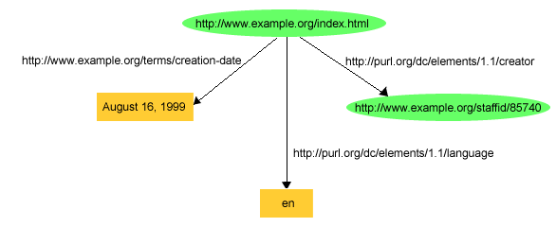
Resource Description Framework (RDF)
✓ RDF/XML
https://www.w3.org/TR/rdf-primer/#rdfxml
1. <?xml version="1.0"?>
2. <rdf:RDF xmlns:rdf="http://www.w3.org/1999/02/22-rdf-syntax-ns#"
3. xmlns:dc="http://purl.org/dc/elements/1.1/"
4. xmlns:exterms="http://www.example.org/terms/">
5. <rdf:Description rdf:about="http://www.example.org/index.html">
6. <exterms:creation-date>August 16, 1999</exterms:creation-date>
7. <dc:language>en</dc:language>
8. <dc:creator rdf:resource="http://www.example.org/staffid/85740"/>
9. </rdf:Description>
10. </rdf:RDF>

Slide 16
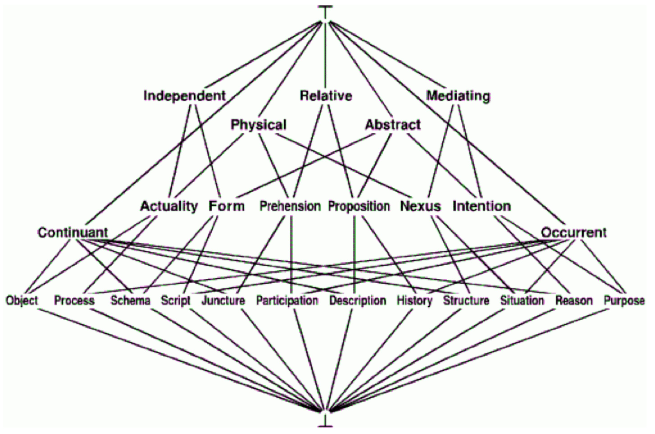
Resource Description Framework (RDF)
✓ Turtle
@prefix rdf:<http://www.w3.org/1999/02/22-rdf-syntax-ns#>.
@prefix rdfs:<http://www.w3.org/2000/01/rdf-schema#>.
@prefix dc:<http://purl.org/dc/elements/1.1/>.
@prefix dt:<http://purl.org/dc/dcmitype/>.
@prefix ns:<http://ns.condillac.org/ex#>.
ns:the_theory_of_physics
a dt:Text ;
dc:title “The theory of physics" ;
dc:creator ns:duhem ;
dc:subject <http://…./physics>.
Ontology of Sciences
Vocabulary (ontology)
a == rdf:type

Slide 17
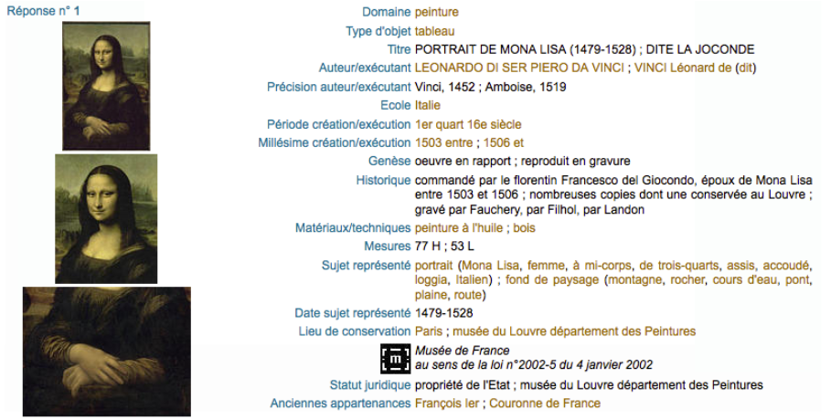
Vocabularies – Ontologies – Terminologies?
Vocabulary
Terminology
Ontology
Vocabulary
Terminology
Ontology
Properties
Values

Slide 18
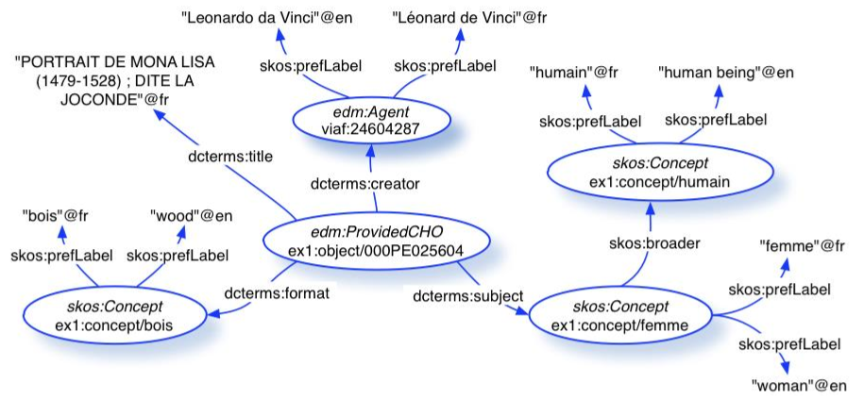
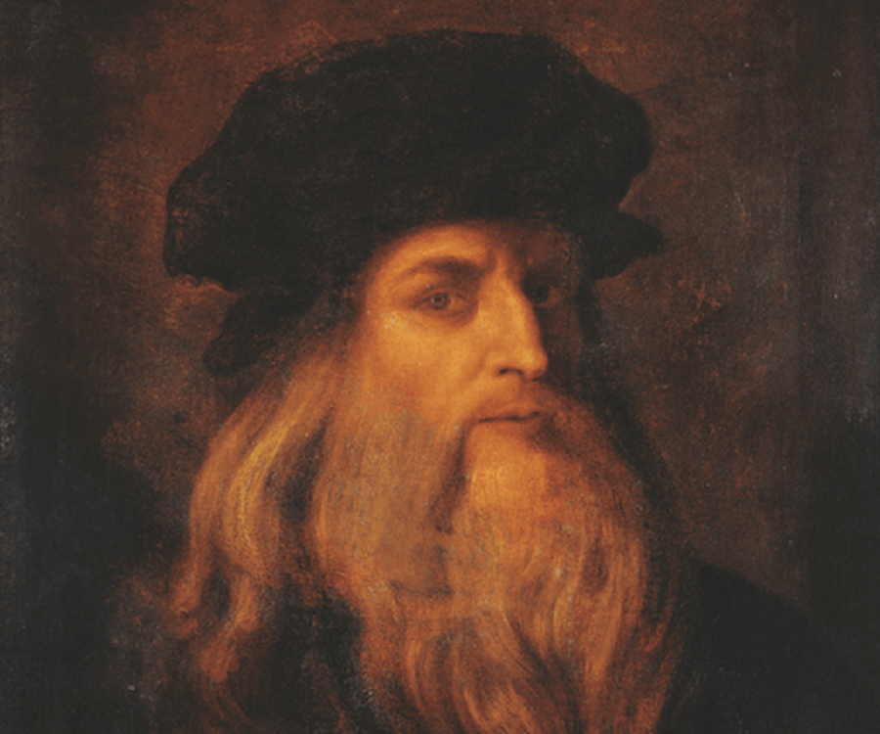
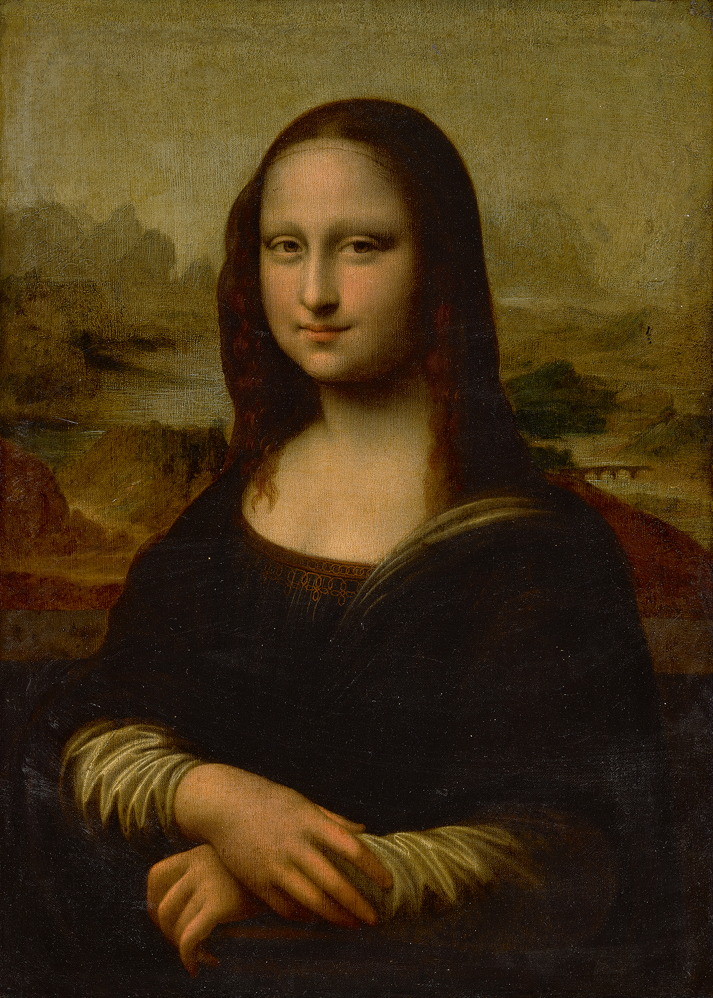
Vocabularies – Ontologies – Terminologies?
Ontologies
Vocabularies
Concepts
Relations
Human
subclass
subclass
Man
Woman
Material
subclass
subclass
Wood
Metal

Slide 19
Vocabularies – Ontologies – Terminologies?
https://www.w3.org/standards/semanticweb/ontology
What is a Vocabulary?
On the Semantic Web, vocabularies define the concepts and relationships (also referred to as “terms”) used to describe and represent an area of concern.
Vocabularies are used to classify the terms that can be used in a particular application, characterize possible relationships, and define possible constraints on using those terms.
In practice, vocabularies can be very complex (with several thousands of terms) or very simple (describing one or two concepts only).
There is no clear division between what is referred to as “vocabularies” and “ontologies”. The trend is to use the word “ontology” for more complex, and possibly quite formal collection of terms, whereas “vocabulary” is used when such strict formalism is not necessarily used or only in a very loose sense. Vocabularies are the basic building blocks for inference techniques on the Semantic Web.

Slide 20
Vocabularies – Ontologies – Terminologies
✓ RDF
✓ RDFS (RDF Schema)
✓ DC
✓ FOAF
✓ SKOS
✓ OWL

Slide 21
RDF Vocabulary
Vocabulary¹ RDF :
« An RDF vocabulary is a collection of IRIs intended for use in RDF graphs. »
An RDF triple consists of three components:
- the subject, which is an IRI or a blank node
- the predicate, which is an IRI
- the object, which is an IRI, a literal or a blank node
IRI: Internationalized Resource Identifier
The Internationalized Resource Identifier (IRI) – is an internet protocol standard which extends the ASCII characters subset of the Uniform Resource Identifier (URI) protocol. While URIs are limited to a subset of the ASCII character set, IRIs may contain characters from the Universal Character Set (Unicode/ISO 10646), including Chinese, Japanese kanji, Korean, and Cyrillic characters.
¹ : Ontology = Vocabulary whose terms are formally defined

Slide 22
RDFS Vocabulary
Vocabulary RDF Schema 1.1 (www.w3.org/TR/rdf-schema/)
RDF Schema provides a data-modelling vocabulary for RDF data.
RDF Schema is an extension of the basic RDF vocabulary.
rdf:Property
rdfs:domain
rdfs:range

Slide 23
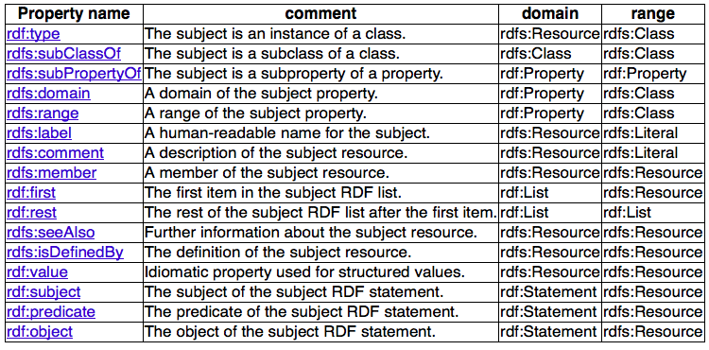
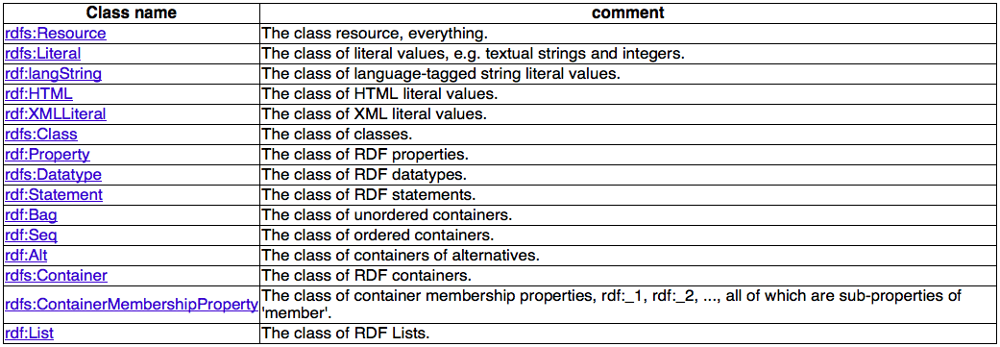
RDF & RDFS VOCABULARIES

Slide 24
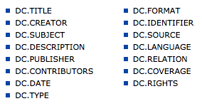
Dublin Core Vocabulary (DC)
Vocabulary Dublin Core
The Dublin Core Schema is a small set of vocabulary terms that can be used to describe digital resources (video, images, web pages, etc.), as well as physical resources such as books or CDs, and objects like artworks. The full set of Dublin Core metadata terms can be found on the Dublin Core Metadata Initiative (DCMI) website. The original set of 15 classic metadata terms, known as the Dublin Core Metadata Element Set (DCMES), is endorsed in the following standards documents:
- IETF RFC 5013
- ISO Standard 15836-1:2017
- NISO Standard Z39.85
Dublin Core metadata may be used for multiple purposes, from simple resource description to combining metadata vocabularies of different metadata standards, to providing interoperability for metadata vocabularies in the linked data cloud and Semantic Web implementations.
15 meta data

Slide 25
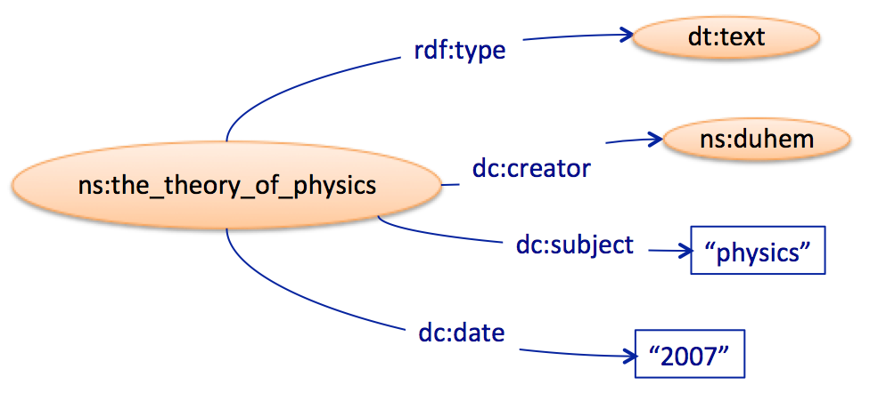
Dublin Core Vocabulary (DC)
Vocabulaire Dublin Core

Slide 26
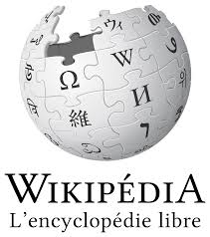
Friend Of A Friend Vocabulary (FOAF)
FOAF (an acronym of Friend of a friend) is a machine-readable ontology describing persons, their activities and their relations to other people and objects. Anyone can use FOAF to describe him- or herself. FOAF allows groups of people to describe social networks without the need for a centralised database.
FOAF is a descriptive vocabulary expressed using the Resource Description Framework (RDF) and the Web Ontology Language (OWL). Computers may use these FOAF profiles to find, for example, all people living in Europe, or to list all people both you and a friend of yours know.[1][2] This is accomplished by defining relationships between people. Each profile has a unique identifier (such as the person's e-mail addresses, a Jabber ID, or a URI of the homepage or weblog of the person), which is used when defining these relationships.

Slide 27
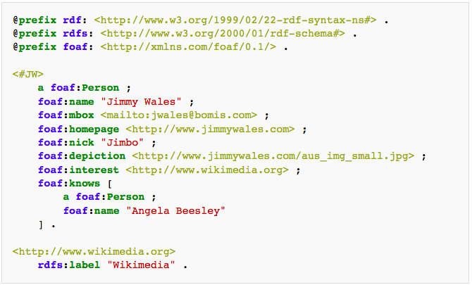
Friend Of A Friend Vocabulary (FOAF)

Slide 28
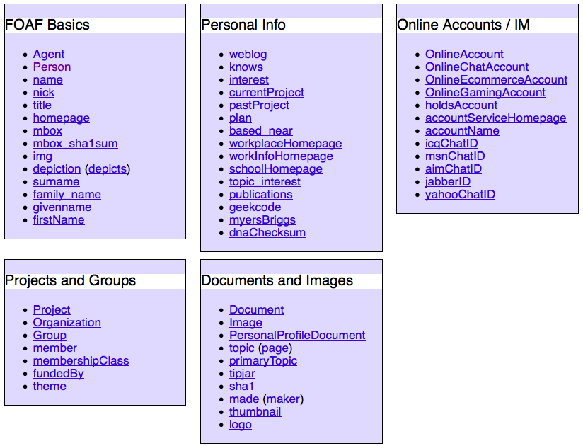
Friend Of A Friend Vocabulary (FOAF)

Slide 29
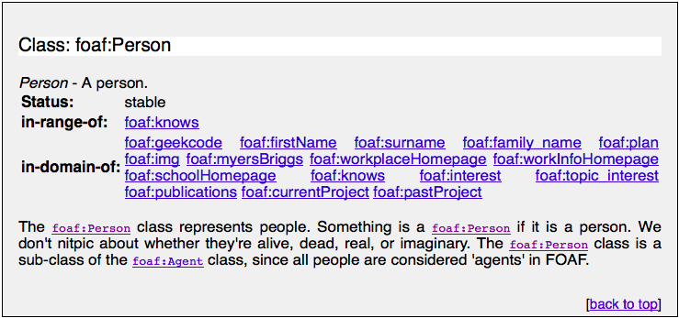
Friend Of A Friend Vocabulary (FOAF)

Slide 30
Simple Knowledge Organization System (SKOS)
https://www.w3.org/TR/skos-reference/
Many knowledge organization systems, such as thesauri, taxonomies, classification schemes and subject heading systems, share a similar structure, and are used in similar applications. SKOS captures much of this similarity and makes it explicit, to enable data and technology sharing across diverse applications.
The SKOS data model provides a standard, low-cost migration path for porting existing knowledge organization systems to the Semantic Web. SKOS also provides a lightweight, intuitive language for developing and sharing new knowledge organization systems. It may be used on its own, or in combination with formal knowledge representation languages such as the Web Ontology language (OWL).
skos:Concept
skos:broader
skos:narrower
The properties skos:broader and skos:narrower are used to assert a direct hierarchical link between two SKOS concepts. A triple <A> skos:broader <B> asserts that <B>, the object of the triple, is a broader concept than <A>, the subject of the triple. Similarly, a triple <C> skos:narrower <D> asserts that <D>, the object of the triple, is a narrower concept than <C>, the subject of the triple.

Slide 31
Ontology Web Language Vocabulary (OWL)
Vocabulary OWL (https://www.w3.org/TR/owl-ref/)
The Web Ontology Language OWL is a semantic markup language for publishing and sharing ontologies on the World Wide Web. OWL is developed as a vocabulary extension of RDF (the Resource Description Framework) and is derived from the DAML+OIL Web Ontology Language. This document contains a structured informal description of the full set of OWL language constructs and is meant to serve as a reference for OWL users who want to construct OWL ontologies.
5.2.1 owl:sameAs
The built-in OWL property owl:sameAs links an individual to an individual. Such an owl:sameAs statement indicates that two URI references actually refer to the same thing: the individuals have the same "identity".
For individuals such as "people" this notion is relatively easy to understand. For example, we could state that the following two URI references actually refer to the same person:
<rdf:Description rdf:about="#William_Jefferson_Clinton">
<owl:sameAs rdf:resource="#BillClinton"/>
</rdf:Description>
The owl:sameAs statements are often used in defining mappings between ontologies. It is unrealistic to assume everybody will use the same name to refer to individuals. That would require some grand design, which is contrary to the spirit of the web.

Slide 32
Querying the Knowledge Graph
Main Issues:
Representing Data?
Linking Data?
Searching Data?

Slide 33
SPARQL
✓ A Query Language for RDF Graph
➥ a SPARQL query consists of writing a query graph
Most forms of SPARQL query contain a set of triple patterns called a basic graph pattern.
Triple patterns are like RDF triples except that each of the subject, predicate and object may be a variable.
➥ Retrieval: - graph matching
- graphs which match with the query graph
A basic graph pattern matches a subgraph of the RDF data when RDF terms from that subgraph may be substituted for the variables and the result is RDF graph equivalent to the subgraph.

Slide 34
SPARQL
I’m looking for the names of people
foaf:Person
Graph Pattern
rdf:type
?person
foaf:name
?name
=> all the possible couples of values of ?person and ?name

Slide 35
SPARQL
✓ SPARQL Protocol And RDF Query Language
http://www.w3.org/TR/rdf-sparql-query/
SPARQL is an RDF query language—that is, a semantic query language for databases—able to retrieve and manipulate data stored in Resource Description Framework (RDF) format.
Similar to SQL for Relational Database
PREFIX foaf: <http://xmlns.com/foaf/0.1/>
SELECT distinct ?name
WHERE
{ ?person rdf:type foaf:Person .
?person foaf:name ?name
}
LIMIT 10
The full-stop expresses the "conjunction"

Slide 36
SPARQL
✓ Queries
Name spaces (prefixes):
prefix p1: <…>
prefix p2:<…>
…
Selected variables:
select…
Query graph pattern:
where {
…
}
Modifiers:
limit…
order by …
Query patterns generate an unordered collection of solutions. These solutions are then treated as a sequence on which sequence modifiers are applied to create another sequence. Finally, this latter sequence is used to generate one of the results of a SPARQL query form.

Slide 37
SPARQL
PREFIX foaf: <http://xmlns.com/foaf/0.1/>
SELECT distinct ?name
WHERE
{ ?person rdf:type foaf:Person .
?person foaf:name ?name
}
LIMIT 10
This query joins together all of the triples with a matching subject, where the type predicate, “rdf:type", is a person (foaf:Person), and the person has one or more names (foaf:name).
The result of the join is a set of rows – ?person, ?name.
This query returns the ?name because ?person is often a complex URI rather than a human-friendly string.

Slide 38
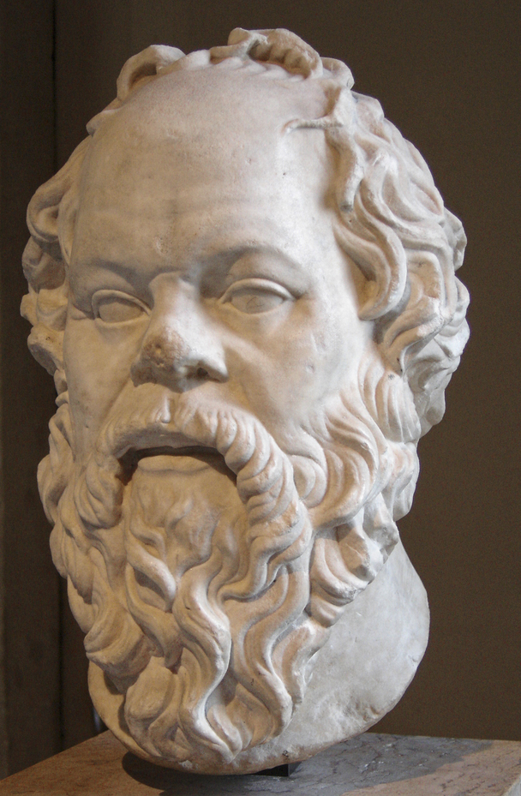
http://fr.dbpedia.org/sparql
select distinct *
where { ?x rdf:type foaf:Person.
?x rdfs:label "Socrate"@fr.
?x foaf:depiction ?z
}

Slide 39
ISSUES
I’m looking for the names of people
Which Vocabularies (Ontologies)?
properties (relations)
concepts
Person
?
?
foaf:Person
dbo:Person
foaf:Agent
<…:NaturalPerson>
rdf:type
rdfs:member
is-a
?person
name
?name
?
foaf:name
skos:prefLabel
rdf:label
Use standardized vocabularies

Slide 40
END

