Slide 1
ΠΕΡΙΕΧΟΜΕΝΑ
ΜΕΡΟΣ Α (πρωί)
1. Παράδειγμα
2. Ψηφιακές Ανθρωπιστικές Επιστήμες
3. Σημασιολογικός Ιστός και Ανοικτά Συνδεδεμένα Δεδομένα
4. Γράφος Γνώσης (RDF, SPARQL)
5. Οντολογία & Αναπαράσταση Γνώσης
ΜΕΡΟΣ Β (απόγευμα)
6. Ερωτήματα σε Γράφους RDF (SPARQL)
Κεραμεικός
Condillac
DBpedia
7. Χτίζοντας Οντολογίες
Cmap Tools
Protégé
Tedi

Slide 2
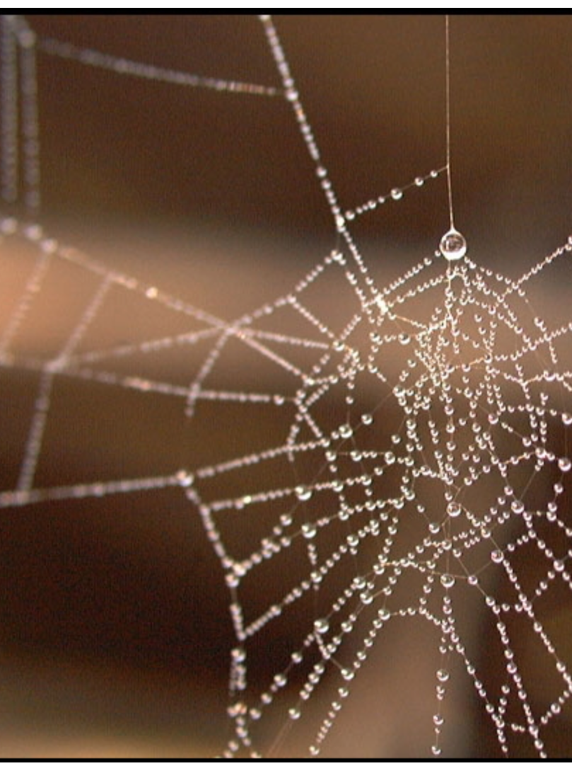
Στην αρχή….

Slide 3
Στη συνέχεια….

Slide 4
Σήμερα…

Slide 5
ΔΕΔΟΜΕΝΑ 5*

Slide 6
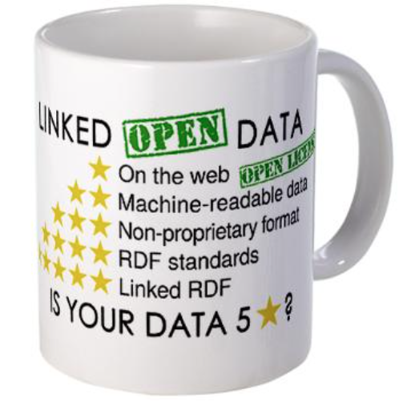
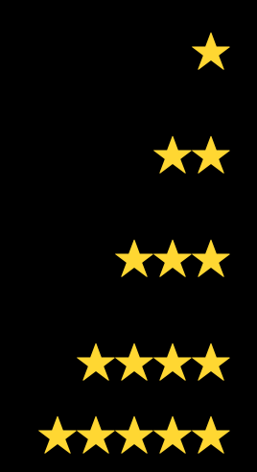
ΔΕΔΟΜΕΝΑ 5*
διαθέσιμα στον ιστό (σε οποιοδήποτε μορφότυπο),
με ανοικτή άδεια χρήσης => Ανοικτά Δεδομένα
+ μηχαναγνώσιμα, δομημένα (π.χ. excel αντί σκαναρισμένης εικόνας)
+ σε δωρεάν μορφότυπα (π.χ. CSV αντί excel)
+ χρήση των ανοικτών προτύπων (standards) του W3C (RDF & SPARQL) για να προσδιορίσουμε τα πράγματα, ώστε κι άλλοι να μπορούν να παραπέμψουν σε αυτά
+ σύνδεση των δεδομένων με δεδομένα άλλων, για περισσότερα συμφραζόμενα
Notes:
https://www.w3.org/DesignIssues/LinkedData.html

Slide 7
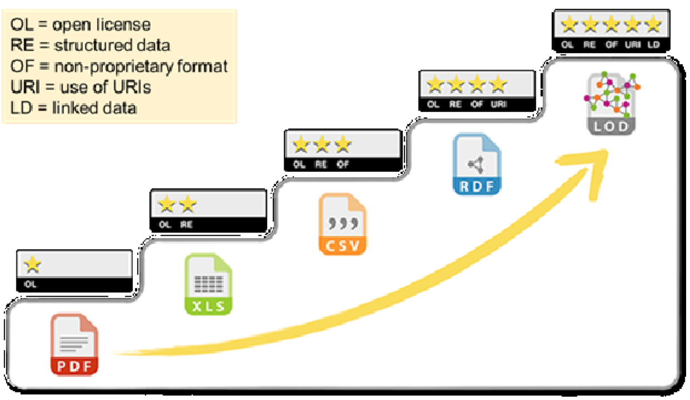
ΚΡΙΤΗΡΙΑ
OL = open licence
RE = structured data
OF = non-proprietary format
URI = use of URIs
LD = linked data
Notes:
https://www.w3.org/DesignIssues/LinkedData.html

Slide 8
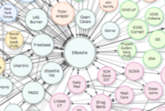
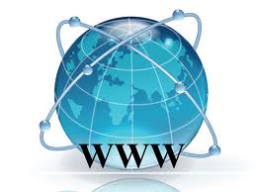
INTRODUCTION
World Wide Web
Web of documents
(web 1.0)
Social Web
(web 2.0)
Web applications
Web services
Web of data
Web of open and linked data
Semantic Web
(web 3.0)

Slide 9
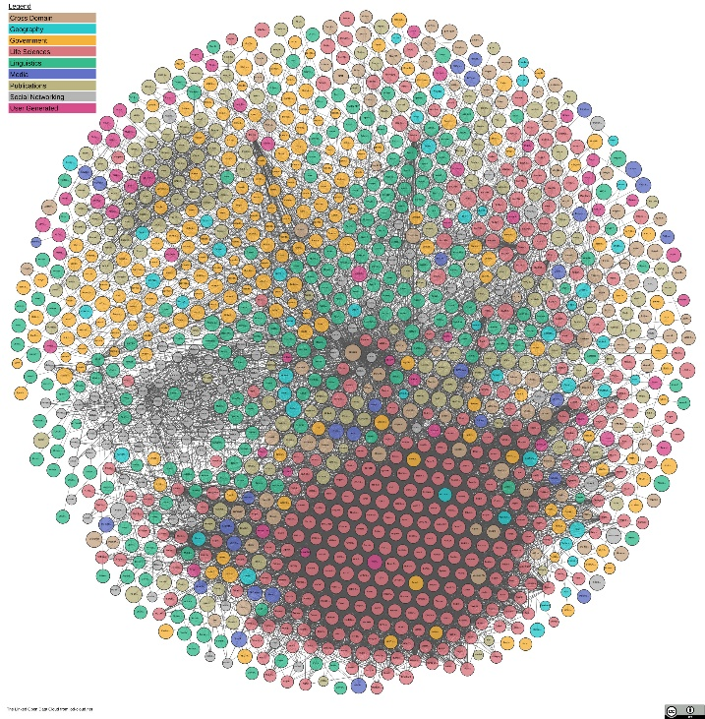
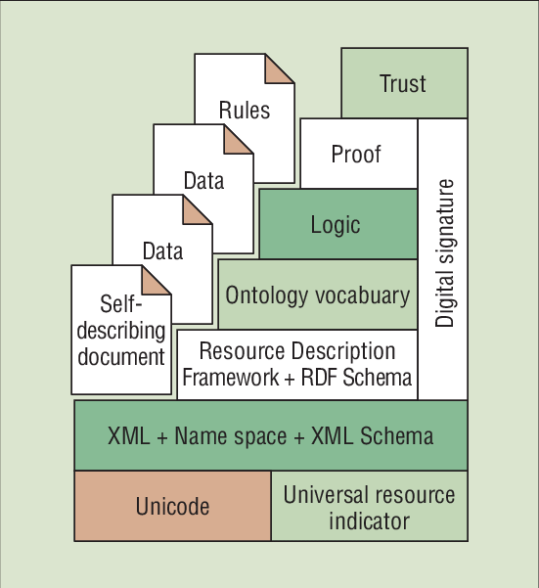
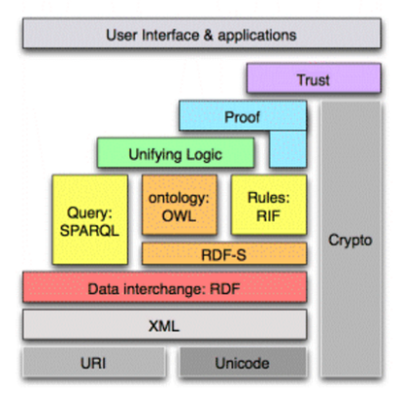
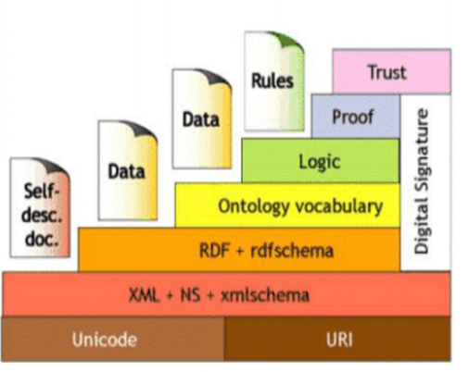
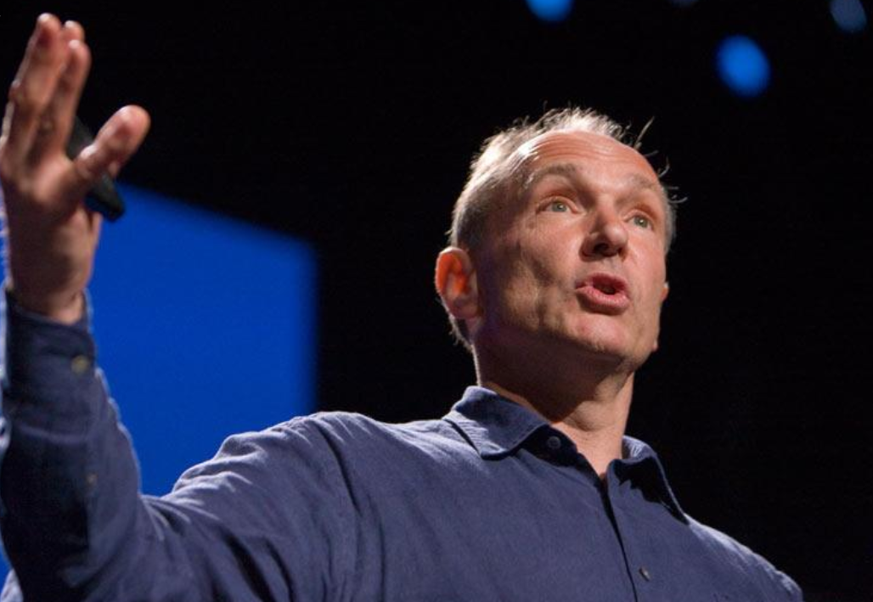
The Semantic Web Stack
2001
2009
2000
2005
2019
https://lod-cloud.net/
Notes:
2000: presented by Tim Berners-Lee
at the XML 2000 conference, 2009: Tim Berners Lee
The next web
Ted Talks

Slide 10
Introduction: History
- Tim Berners-Lee, Consultant at CERN
1980 : program of note taking with creation of links (hypertext)
mainframes
1989 : hypertext for the management of information
links extend (reference) to other web addresses
data and links are decentralized on the internet => (error 404)
- End of 1990 : 1st server and 1er navigator named World Wide Web tested by means of an internet connection (NeXT machine )
- 1993 : web technology from CERN becomes free of charge and free of copyright
- 1994 : Creation of the World Wide Web Consortium (W3C)
Founding members : INRIA, MIT, Keio University
publication of web standards

Slide 11
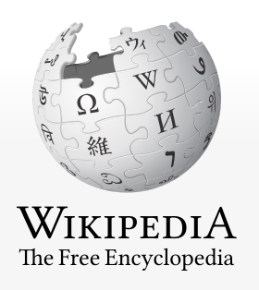
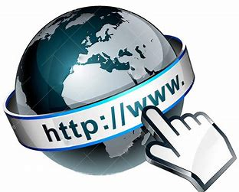
Introduction: the Web
The World Wide Web (WWW), commonly known as the Web, is an information system where documents and other web resources are identified by Uniform Resource Locators (URLs, such as https://www.example.com/), which may be interlinked by hypertext, and are accessible over the Internet. The resources of the WWW may be accessed by users by a software application called a web browser.
Web 1.0 was an early stage of the conceptual evolution of the World Wide Web, centered around a top-down approach to the use of the web and its user interface. […] users could only view webpages but not contribute to the content of the webpages.
A Web 2.0 site may allow users to interact and collaborate with each other in a social media dialogue as creators of user-generated content in a virtual community, in contrast to websites where people are limited to the passive viewing of content. Examples of Web 2.0 include social networking sites, blogs, wikis, folksonomies, video sharing sites, hosted services, web applications, and mashups
Definitions of Web 3.0 vary greatly. Some believe its most important features are the Semantic Web and personalization.

Slide 12
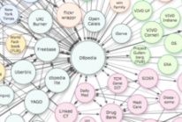
WEB ARCHITECTURE
RDF Store
STORAGE
Reasoner
SWRL
Query Endpoint
SPARQL
RDF
OWL
INFERENCE
ACCESS
SWRL = Semantic Web Rule Language
RDF = Resource Description Framework
OWL = Web Ontology Language
SPARQL = Semantic Search Query Language for RDF
Notes:
https://www.ijcaonline.org/archives/volume167/number11/juneja-2017-ijca-914427.pdf

Slide 13
Web Architecture
✓ 3 fundamental notions (original web)
1. URI (Universal Resource Identifier)
- Unique identifier permitting to reference a resource on a network
URL (Universal Resource Locator)
- Point of access to a representation of a resource on the Web
2. HTTP Protocol (HyperText Transfer Protocol)
- Protocol of client-server communication developed for the Web
3. HTML (HyperText Markup Language)
Markup language of hypertexts dedicated to the representation and the interchange of web pages.
HTML is derived from SGML (Standard Generalized Markup Language), language of description with tags and an ISO standard since 1986 (ISO 8879:1986)

Slide 14
Web Architecture
✓ Textual Interchange format of structured data
XML (Extensible Markup Language)
‘extensible markup language’, computer langage informatique of generic markup derived from SGML; it is an interchange format of structured content (tree structure) between heterogeneous information systems (interoperability).
⇒ Web of structured data
Link the data ?

Slide 15
Web Architecture
✓ RDF (Resource Description Framework)
RDF is a linked data interchange format for the Web.
Data are represented in the form of graphs (set of triplets ‘subject-predicate-object’).
✓ SPARQL (SPARQL Protocol And RDF Query Language)
Query language permitting to search, add, modify and delete RDF data on the Internet.
⇒ Web of data (open) linked
Data management ?
⇒ Metadata (structure, meaning…)
⇒ Semantic Web

Slide 16
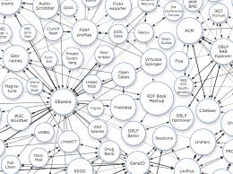
Web Architecture
Web of Open and Linked Data (RDF)
Knowledge Graph (RDF)
No relational schema
Anybody can say anything on any subject (URI)

Slide 17
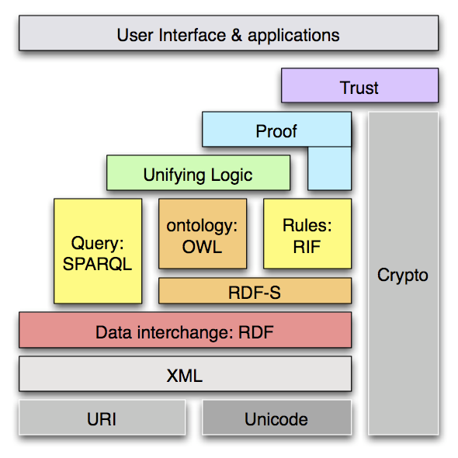
Web Architecture
Semantic web standards (Semantic Web Layer)

Slide 18
Semantic Web
https://en.wikipedia.org/wiki/Semantic_Web
“The ultimate goal of Semantic Web is to make the machine to understand the Internet data. To enable the encoding of semantics with the data, well-known technologies are RDF(Resource Description Framework) and OWL(Web Ontology Language). These technologies formally represent the meaning involved in information”.
“The Semantic Web is an extension of the World Wide Web through standards by the World Wide Web Consortium (W3C). The standards promote common data formats and exchange protocols on the Web, most fundamentally the Resource Description Framework (RDF). According to the W3C, "The Semantic Web provides a common framework that allows data to be shared and reused across application, enterprise, and community boundaries”. The Semantic Web is therefore regarded as an integrator across different content, information applications and systems.”
“The term was coined by Tim Berners-Lee for a web of data (or data web) that can be processed by machines—that is, one in which much of the meaning is machine-readable.”

Slide 19
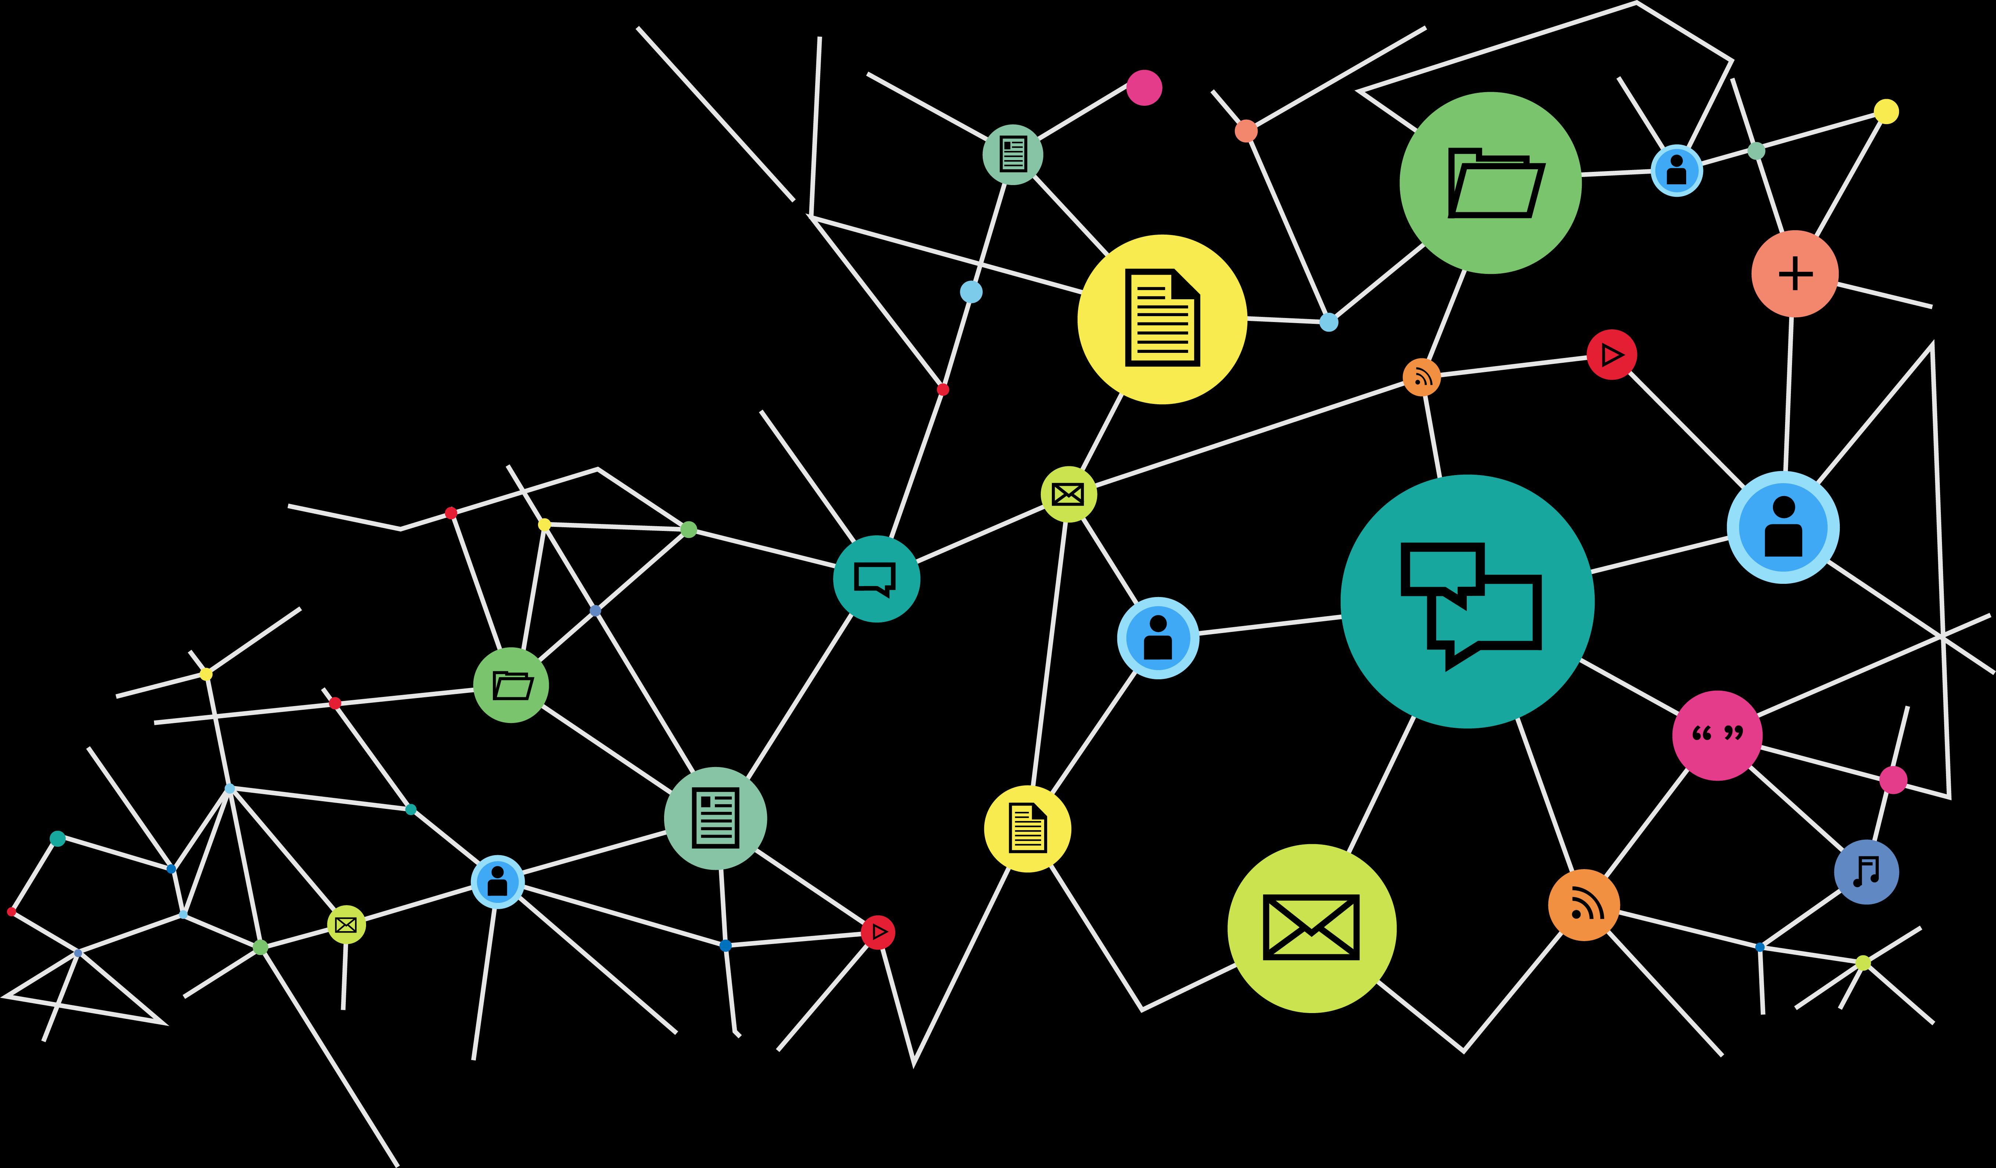
Linked and Open Data
“LOD is often thought of as a virtual data cloud where anyone can access any data they are authorized to see and may also add to any data without disturbing the original data source. This provides an open environment where data can be created, connected and consumed on internet scale. A basic theory of LOD is that data has more value if it can be connected to other data. Data, in this context, is any structured web-based information.”
https://www.w3.org/egov/wiki/Linked_Open_Data
Knowledge Graph
“In computing, linked data (often capitalized as Linked Data) is structured data which is interlinked with other data so it becomes more useful through semantic queries. It builds upon standard Web technologies such as HTTP, RDF and URIs, but rather than using them to serve web pages only for human readers, it extends them to share information in a way that can be read automatically by computers. Part of the vision of linked data is for the Internet to become a global database.”
https://en.wikipedia.org/wiki/Linked_data

Slide 20
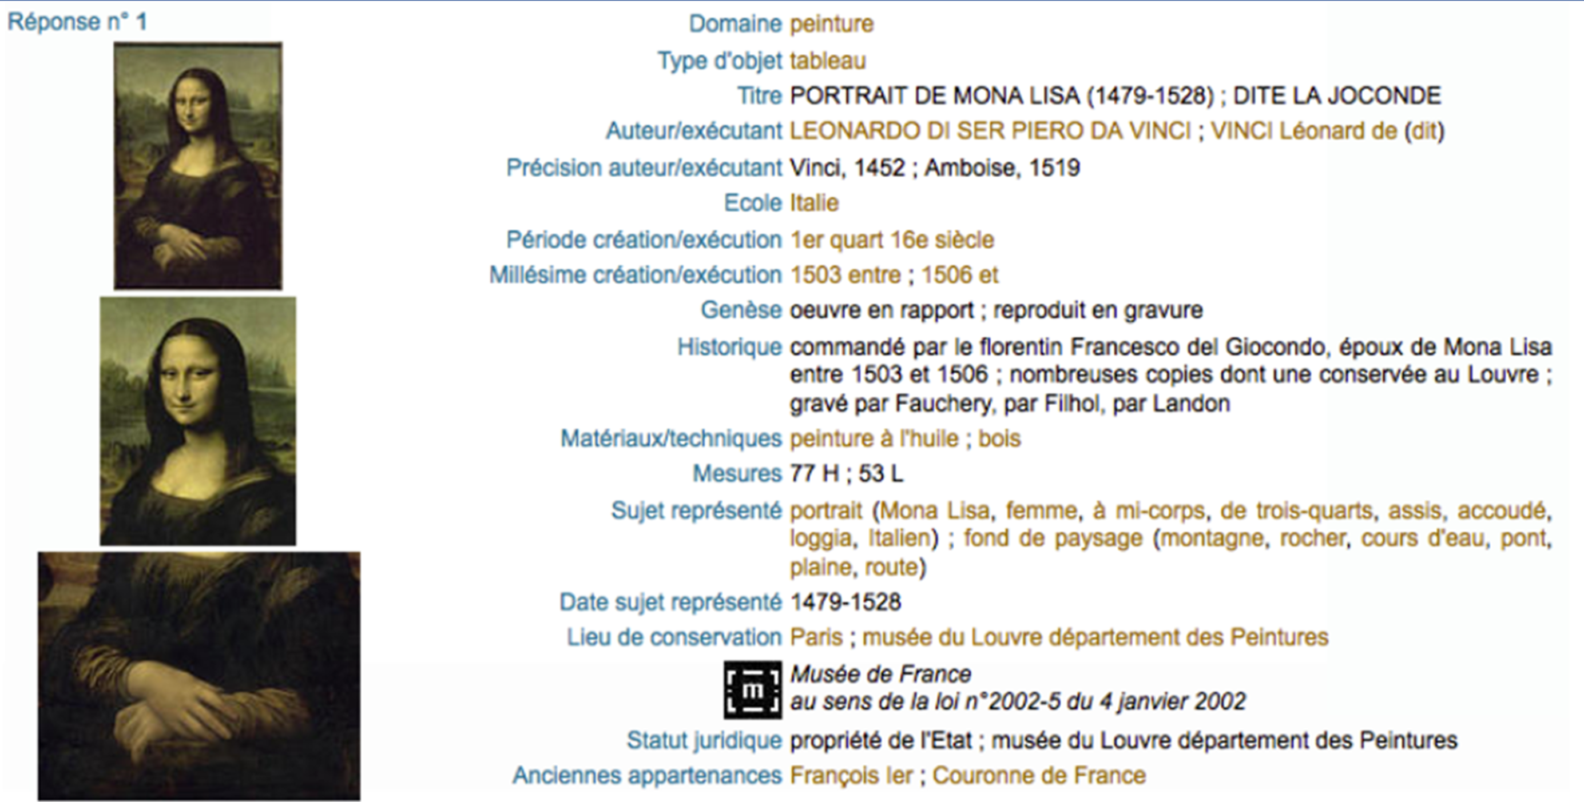
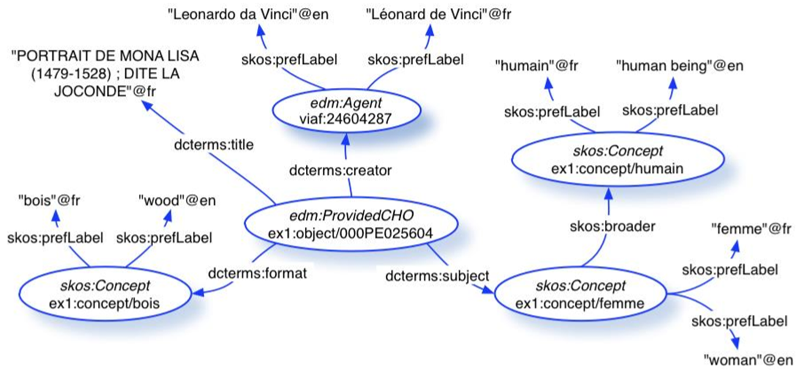
Issues
How to Represent Data:
Accessible (open)
Computer Readable
Interoperable (shareable)
Linkable
Knowledge Graph
Ontology-Terminology

Slide 21
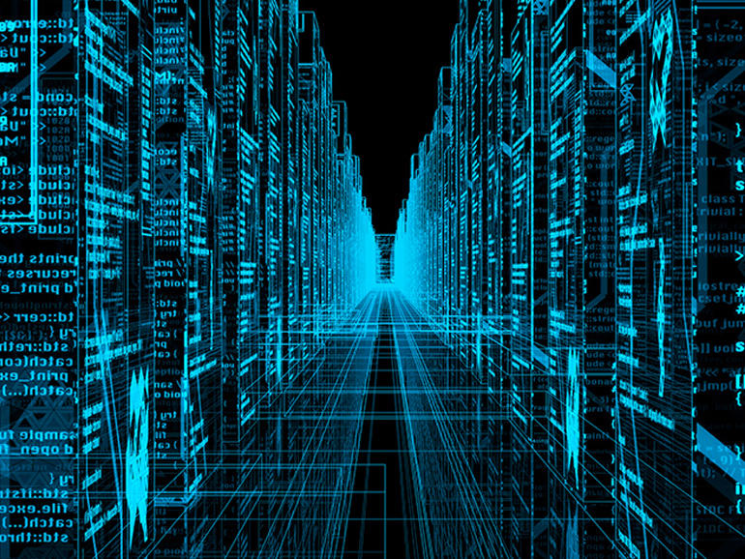
The Web is Big
and it’s getting bigger every day
Notes:
https://www.zdnet.com

Slide 22
END PART 3

Slide 23
https://www.go-fair.org/fair-principles/

